Slide 1
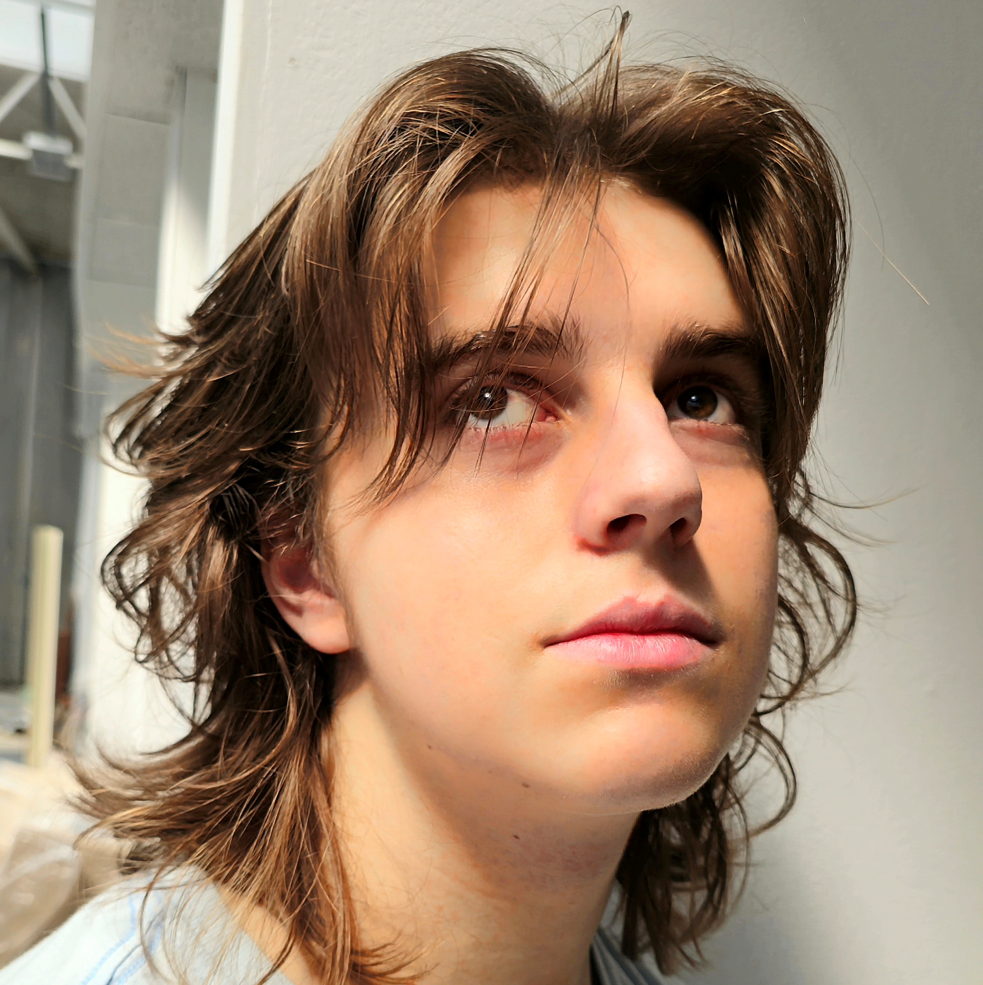
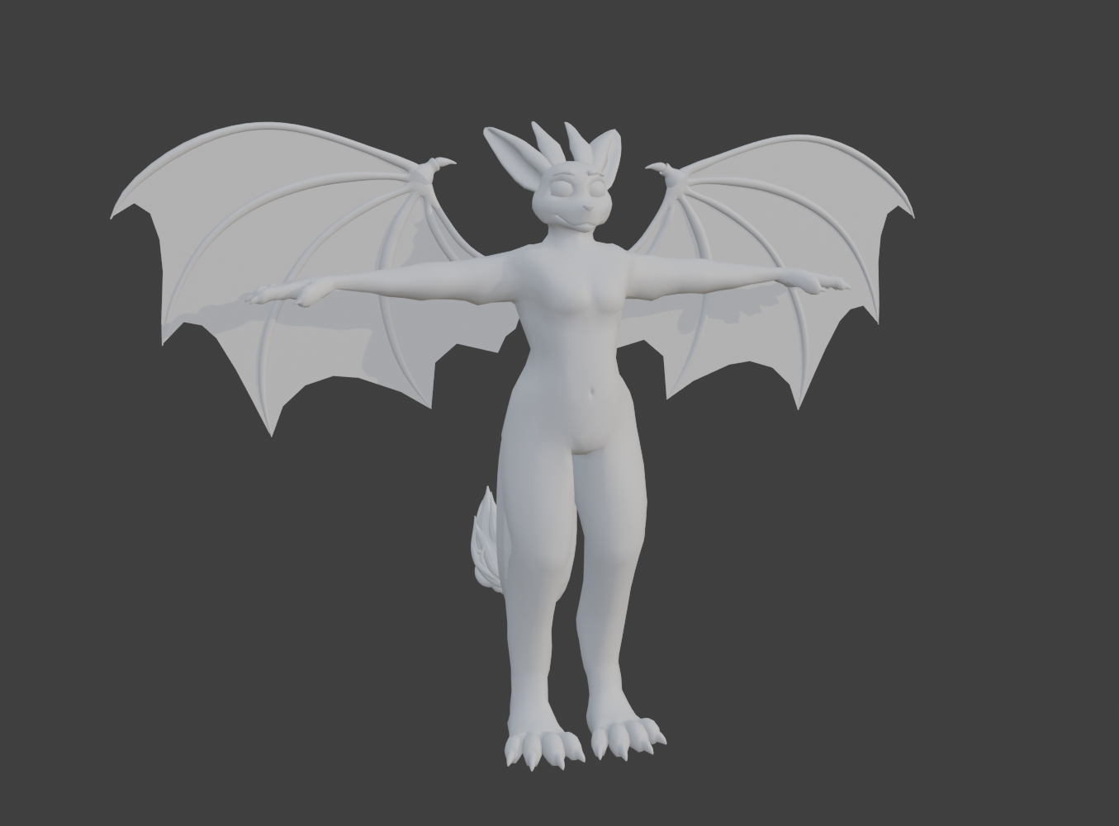
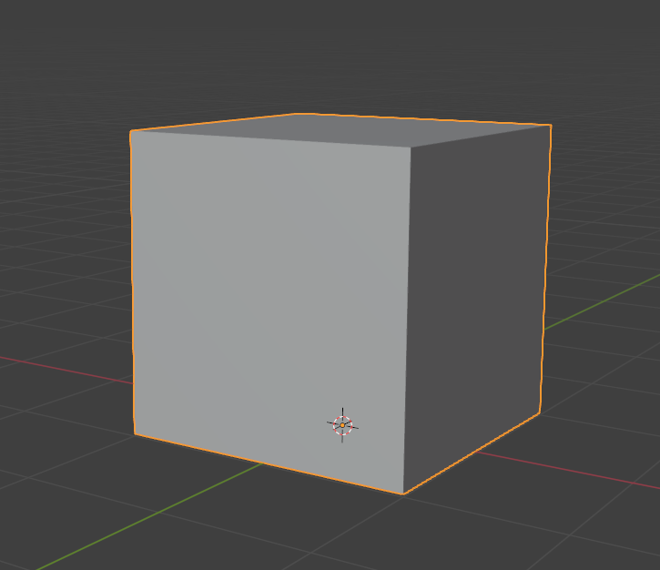
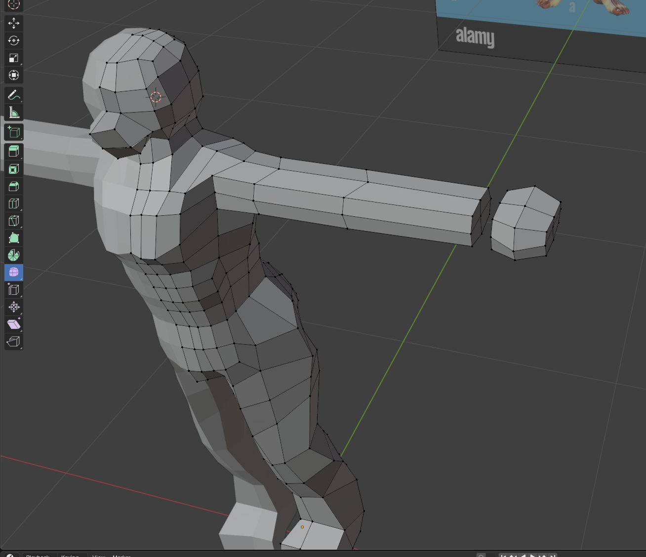
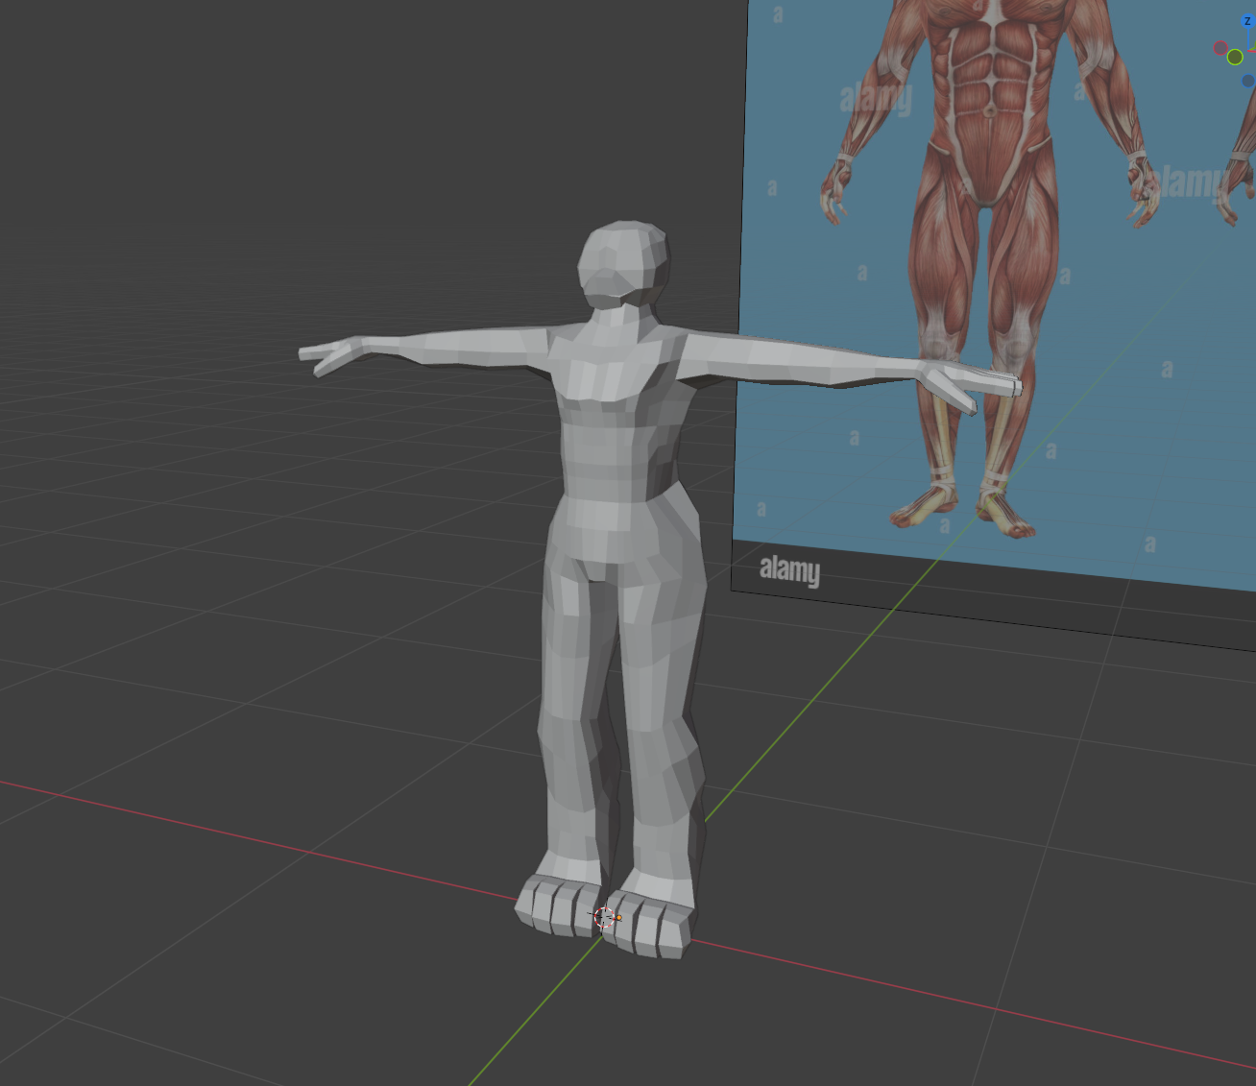
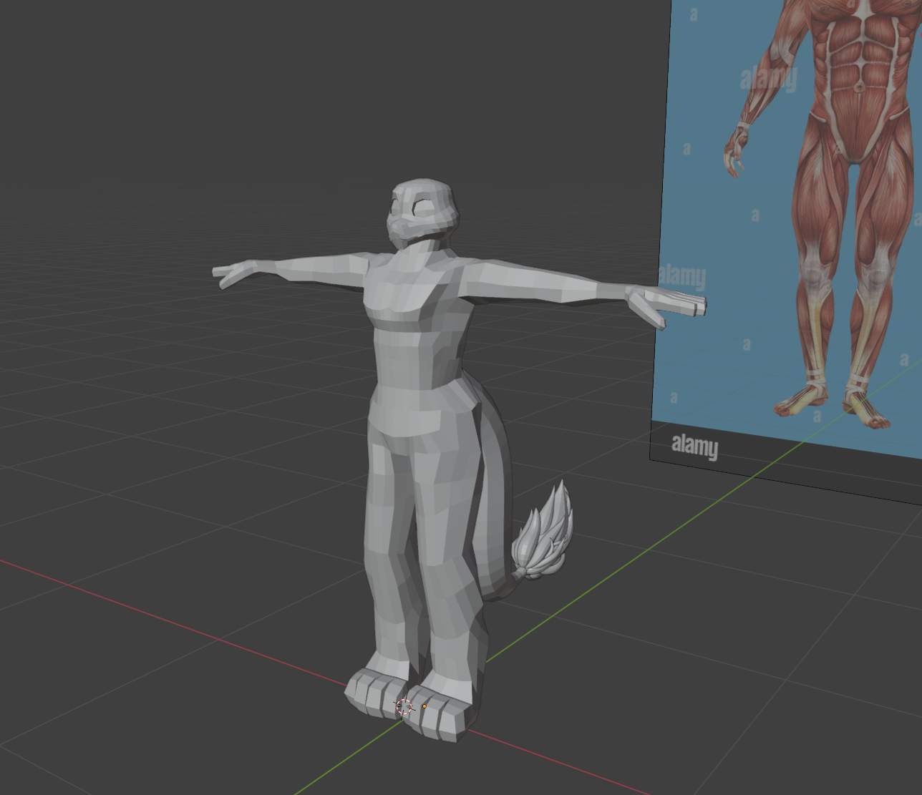
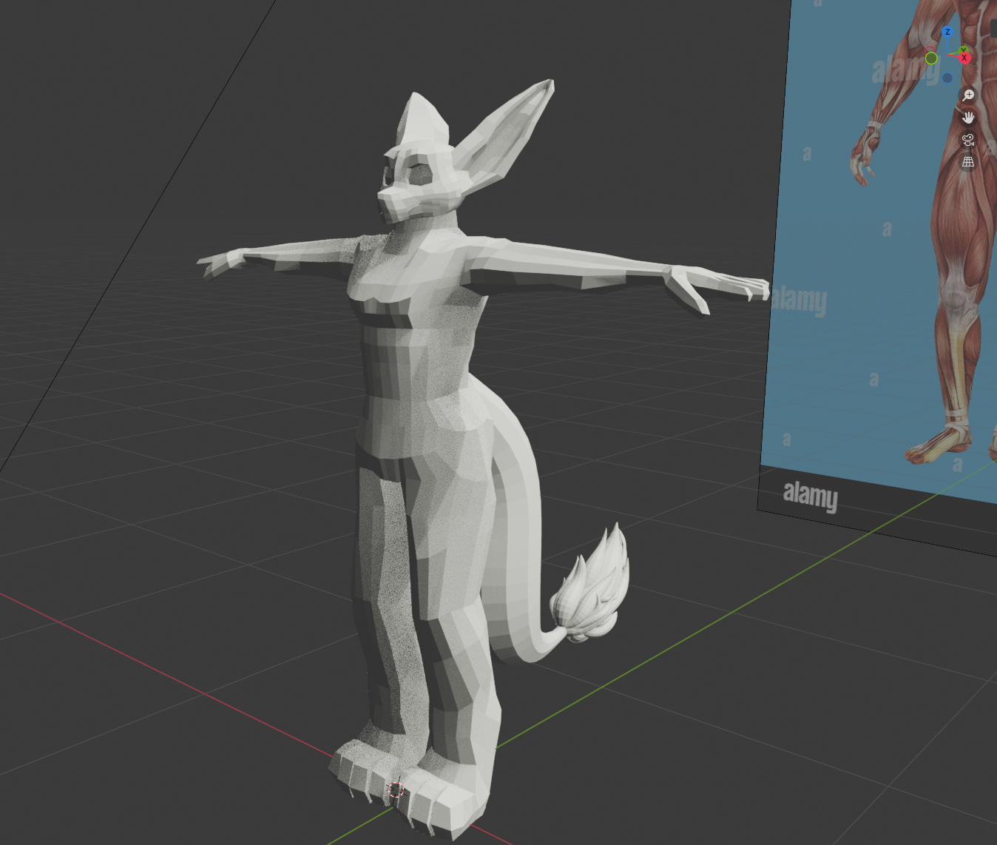
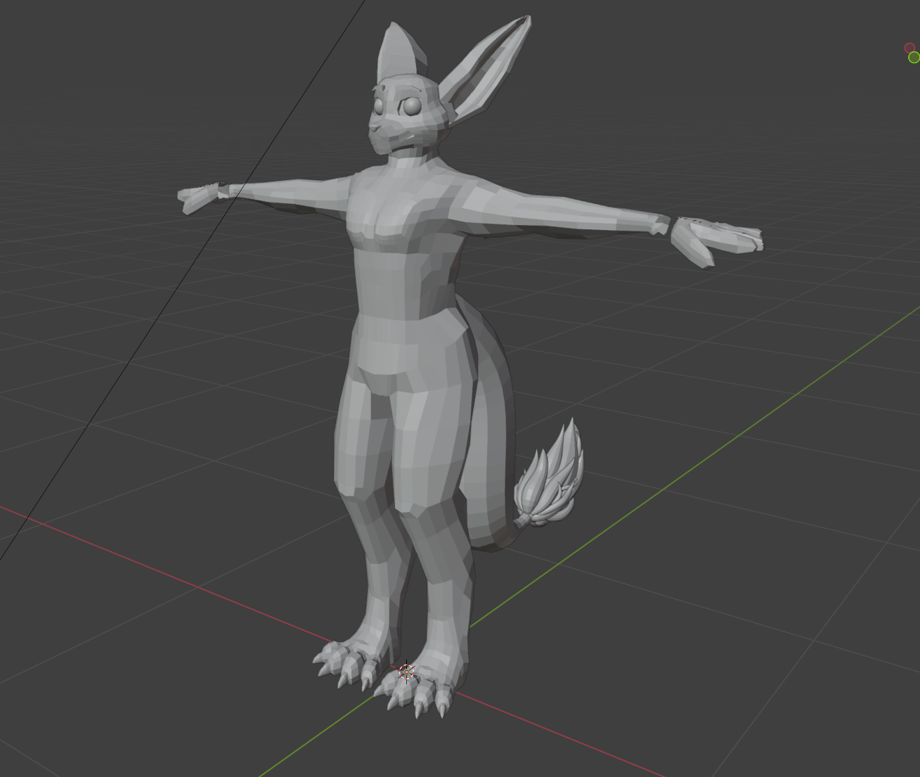
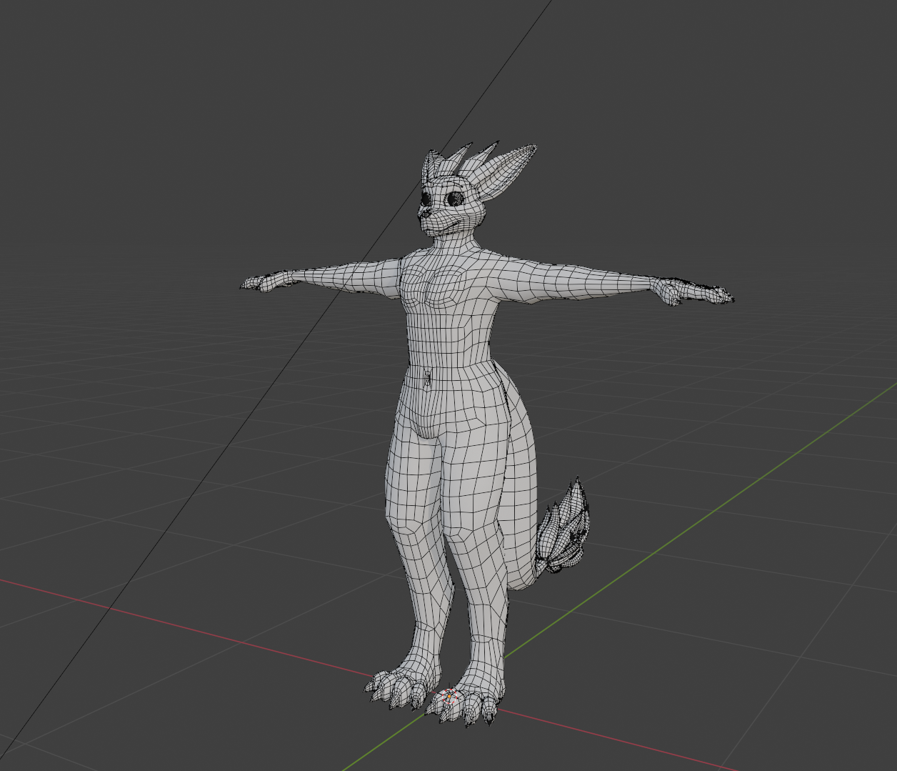
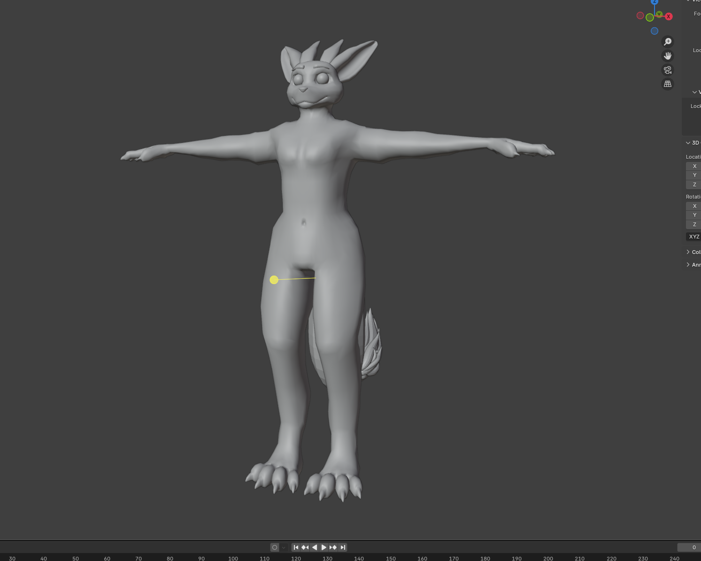
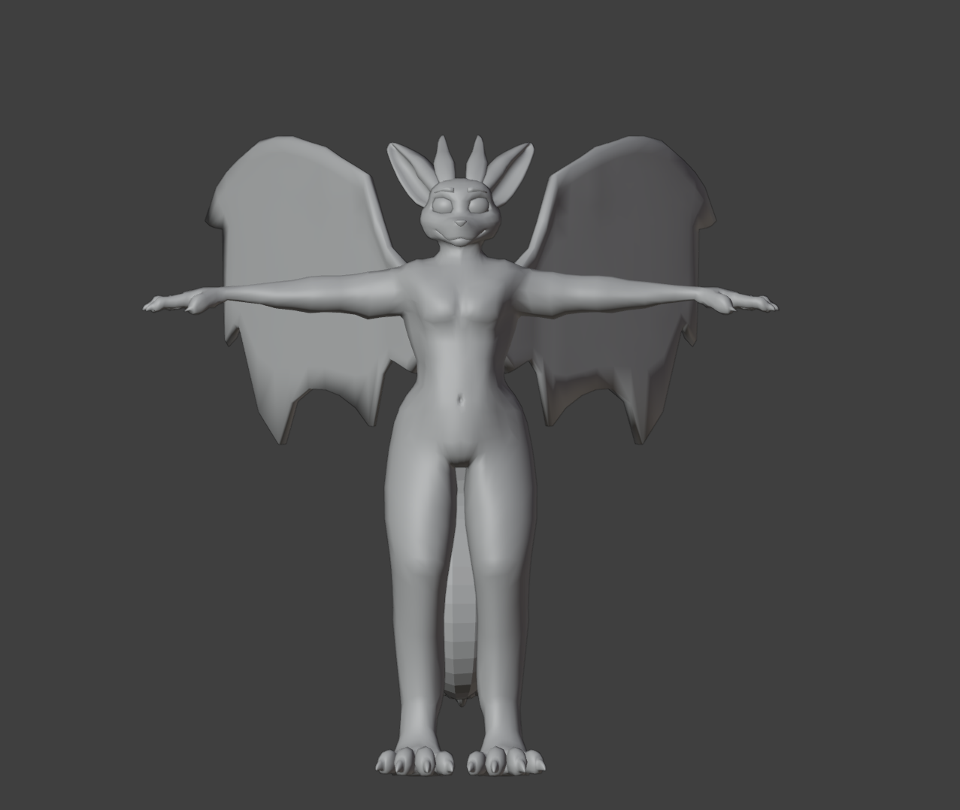
Animation Portfolio
About Me
Better quality in website Portfolio version: My Animation Portfolio
Make sure to enable content otherwise the videos won’t work!
My name is Charlie Morton,
I'm a young artist whose passion is animating in 2D, 3D and modeling 3D!
My Projects
Dragon 3D Model
In making this portfolio I open with my project ‘Dragon’ which is close to my heart as it is my first real exploration and self-taught 3d project. Dragon is a complex project currently ‘underway’, the character borne and evolving from my own imagination. Dragon is my current "Lycée" project whereby my professor asked students to create their projects with a rapport between ‘Real and Virtual’.

Slide 2
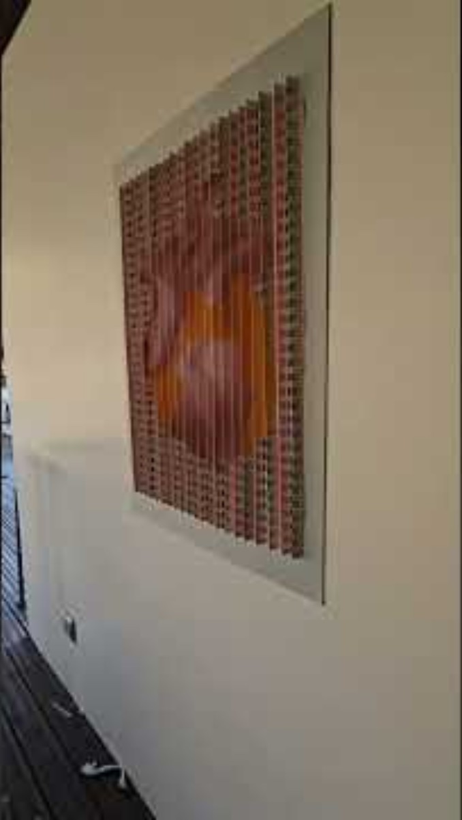
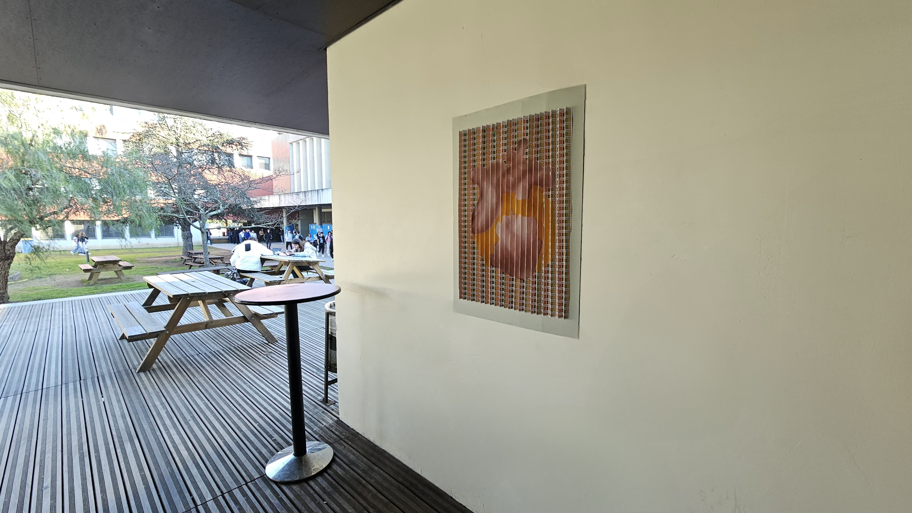
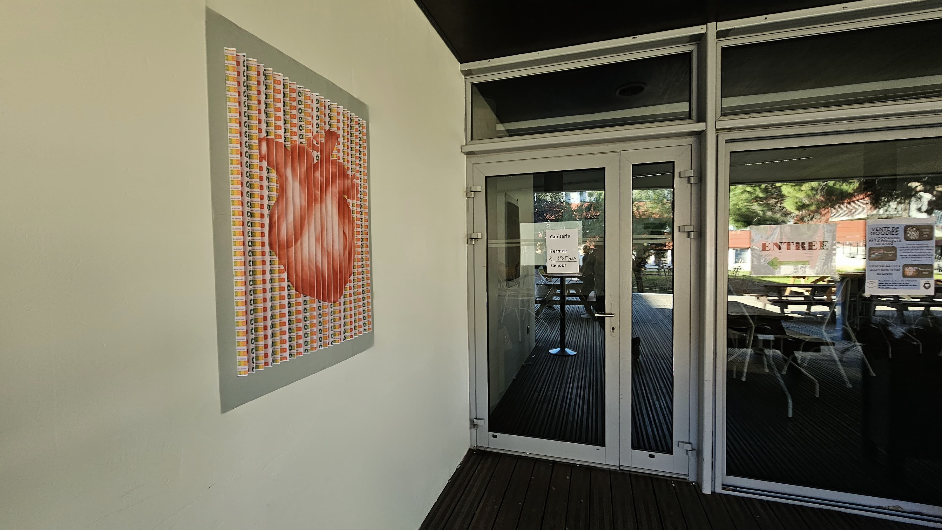
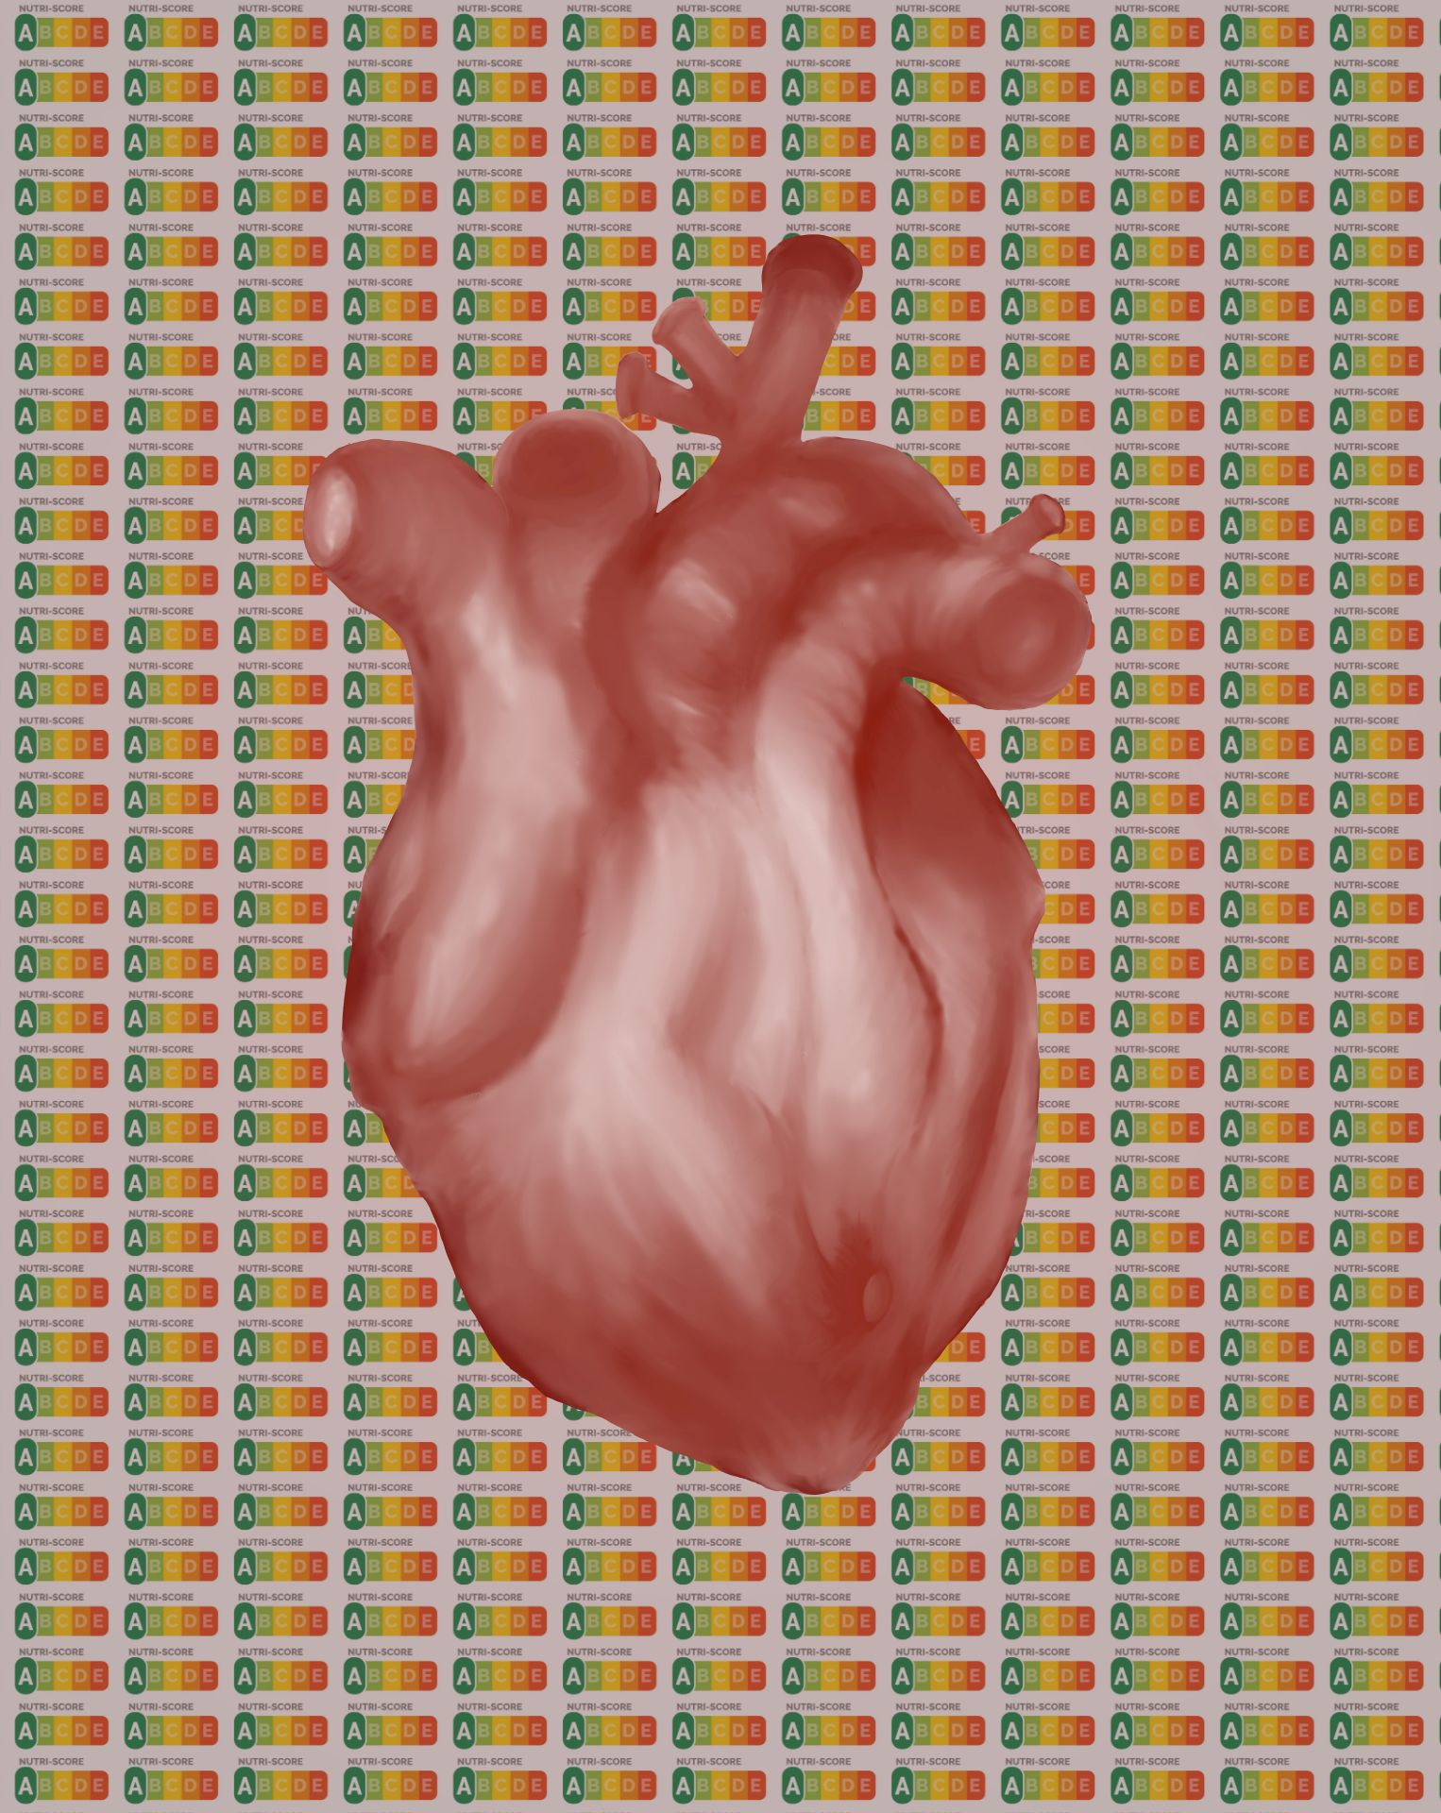
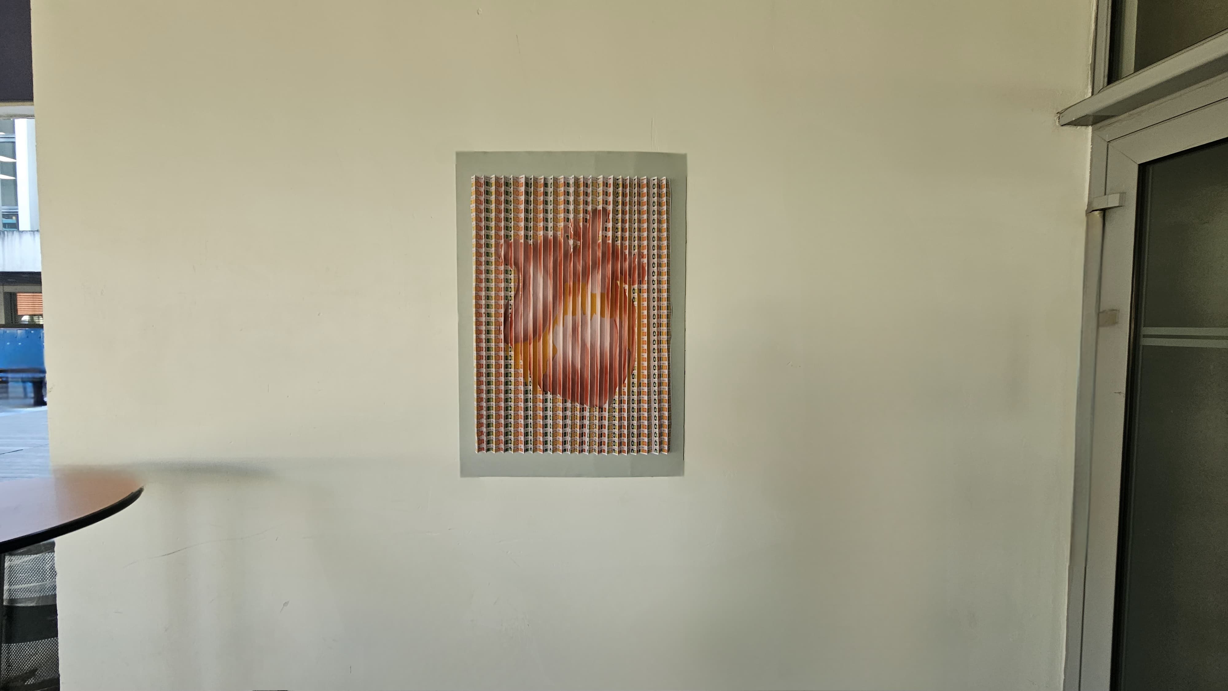
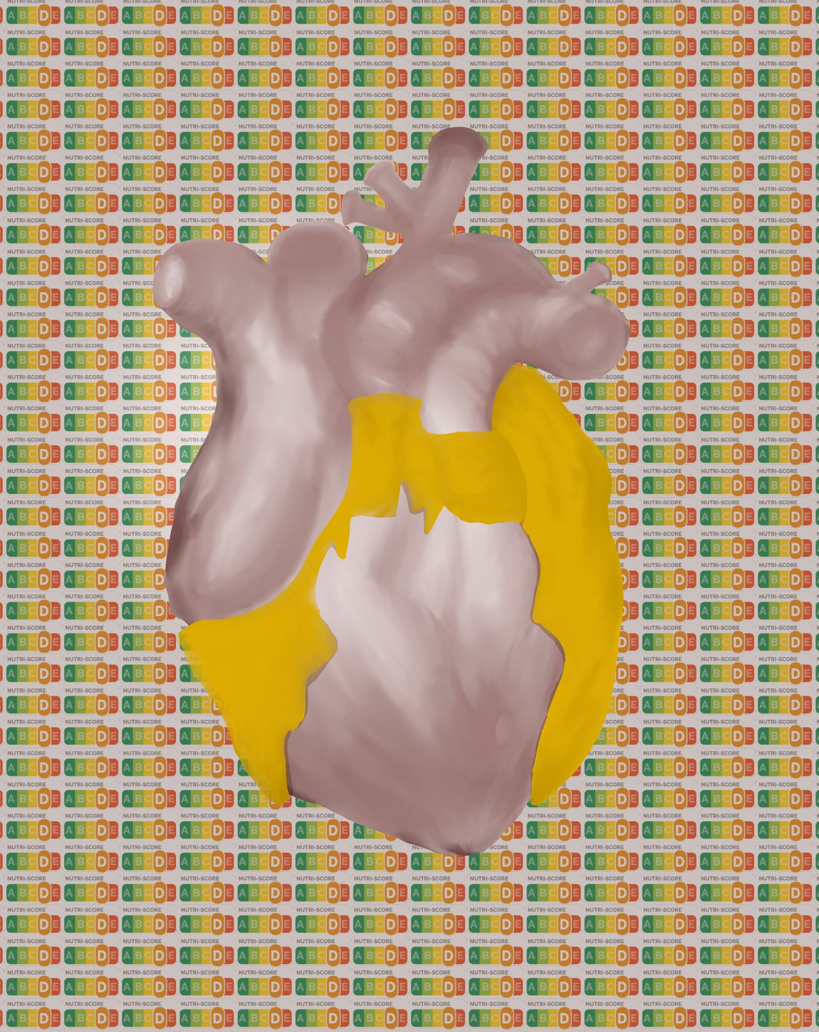
Animation Portfolio
About Me
Better quality in website Portfolio version: My Animation Portfolio
Make sure to enable content otherwise the videos won’t work!
My name is Charlie Morton,
I'm a young artist whose passion is animating in 2D, 3D and modeling 3D!
My Projects
Dragon 3D Model
In making this portfolio I open with my project ‘Dragon’ which is close to my heart as it is my first real exploration and self-taught 3d project. Dragon is a complex project currently ‘underway’, the character borne and evolving from my own imagination. Dragon is my current "Lycée" project whereby my professor asked students to create their projects with a rapport between ‘Real and Virtual’.
Heart Installation
It is preferable to open the video in a browser.
Malnutrition à la cafète

Slide 3
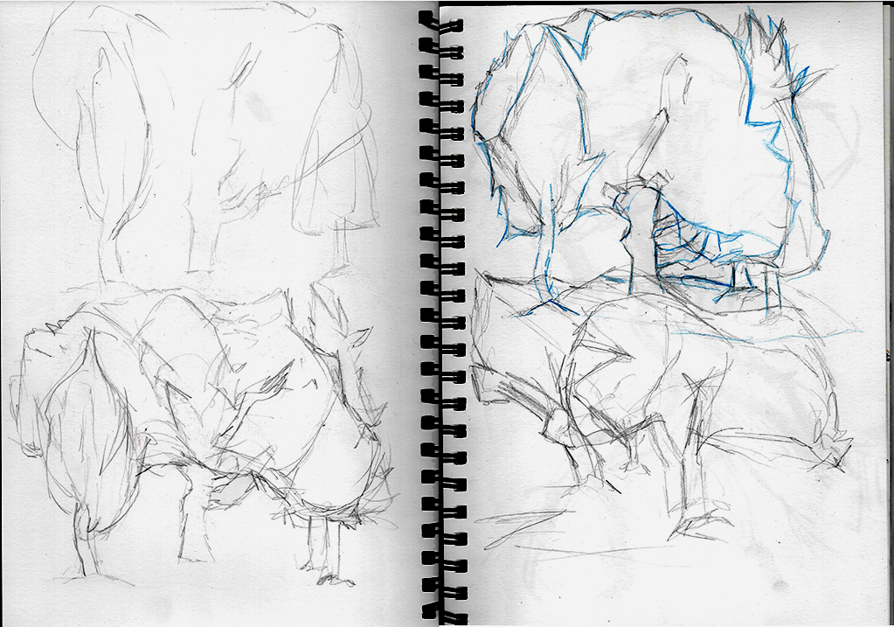
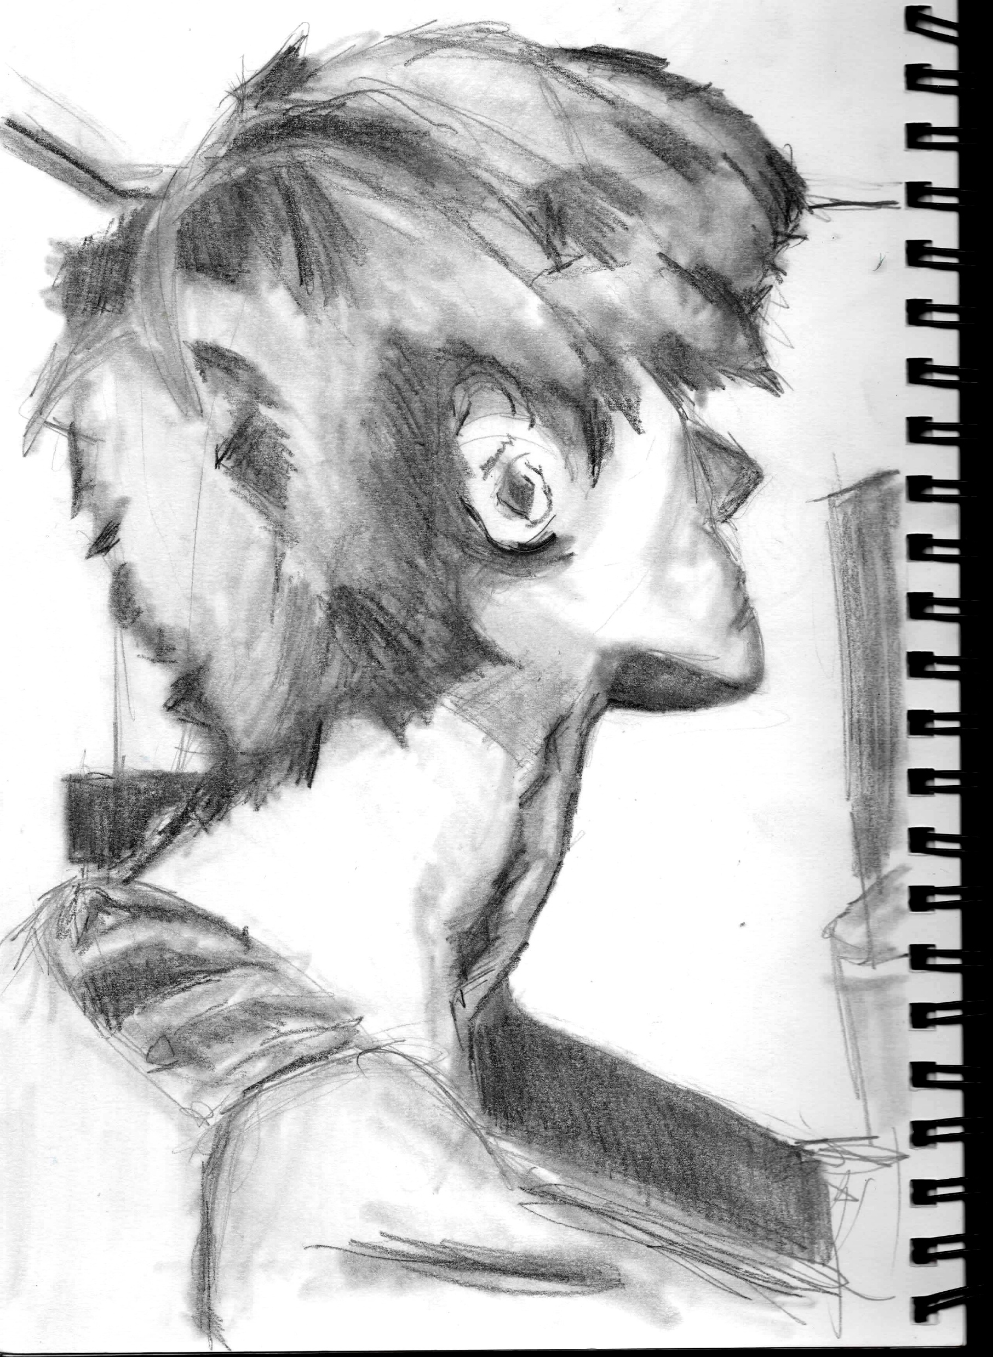
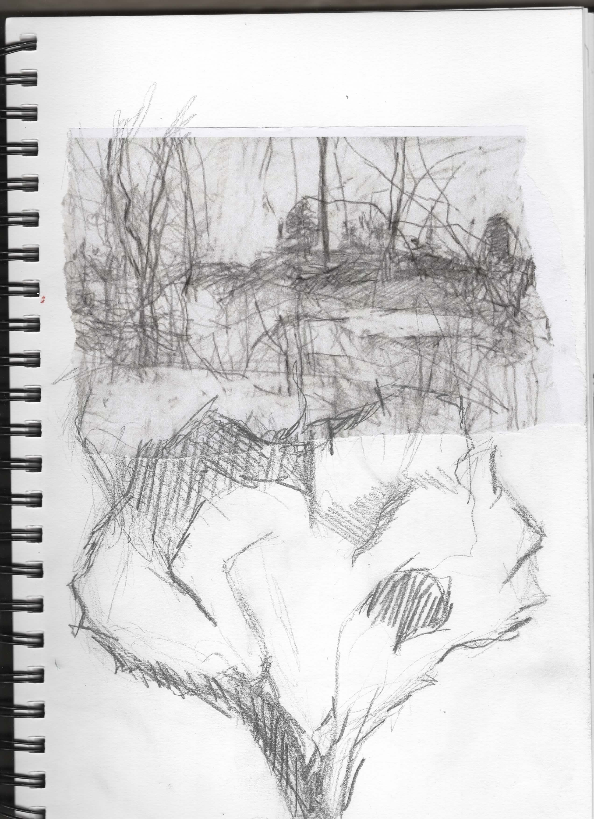
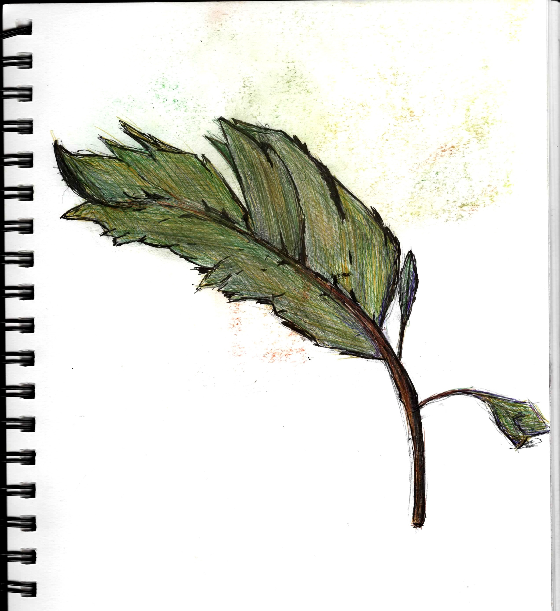
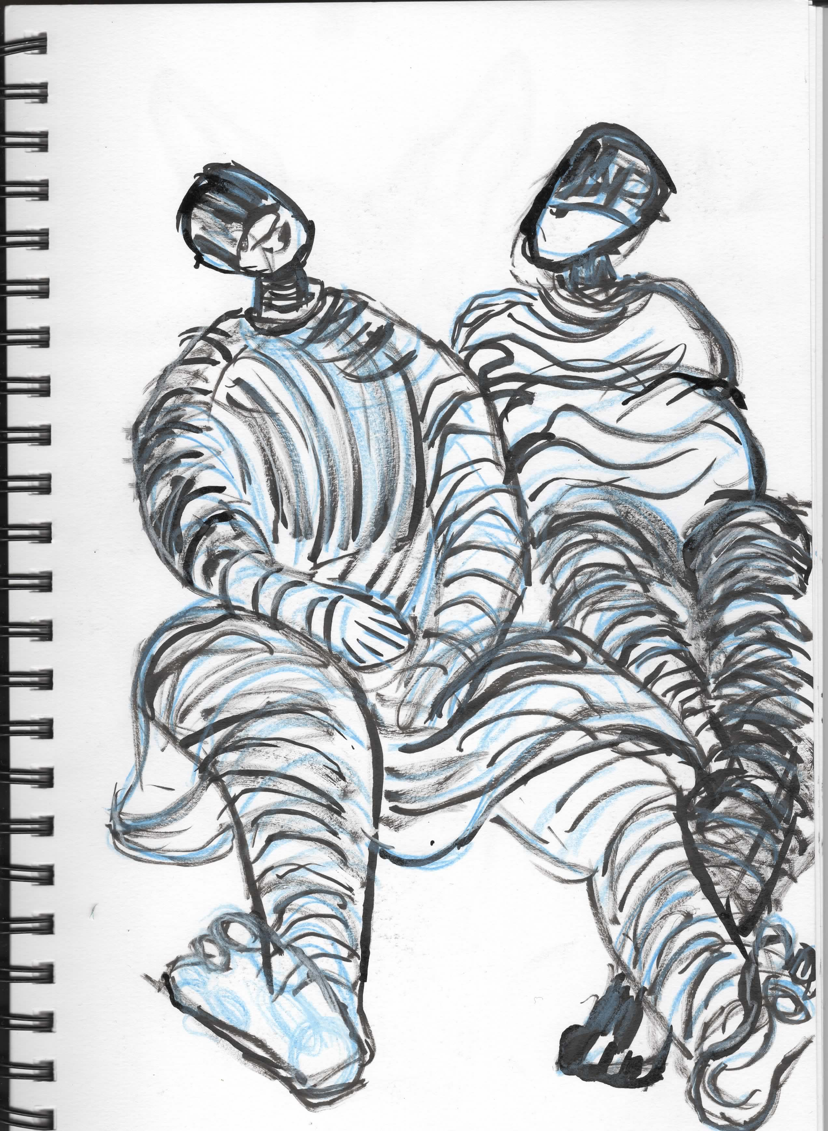
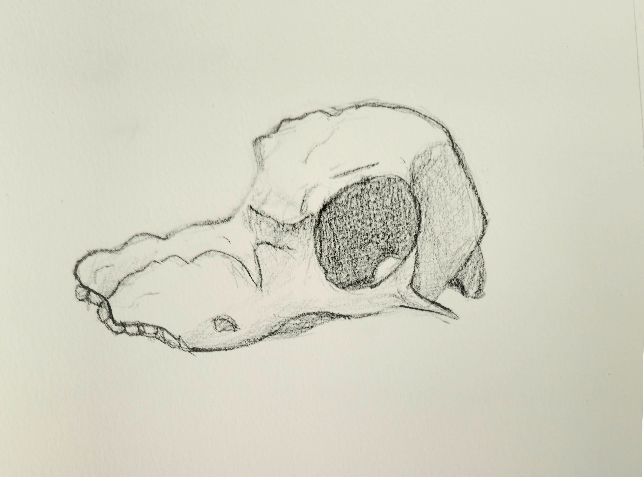
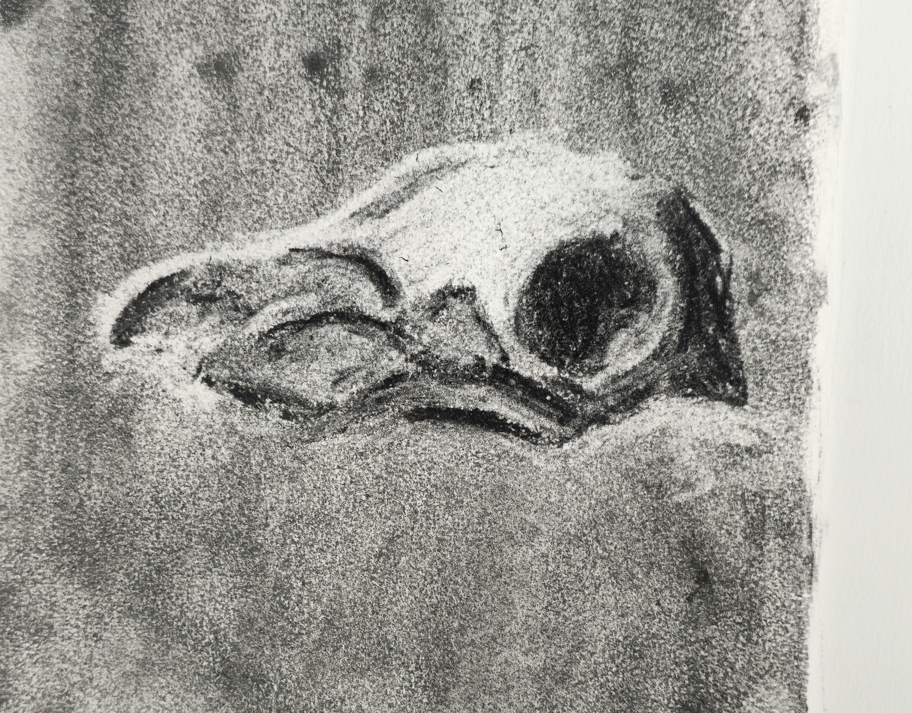
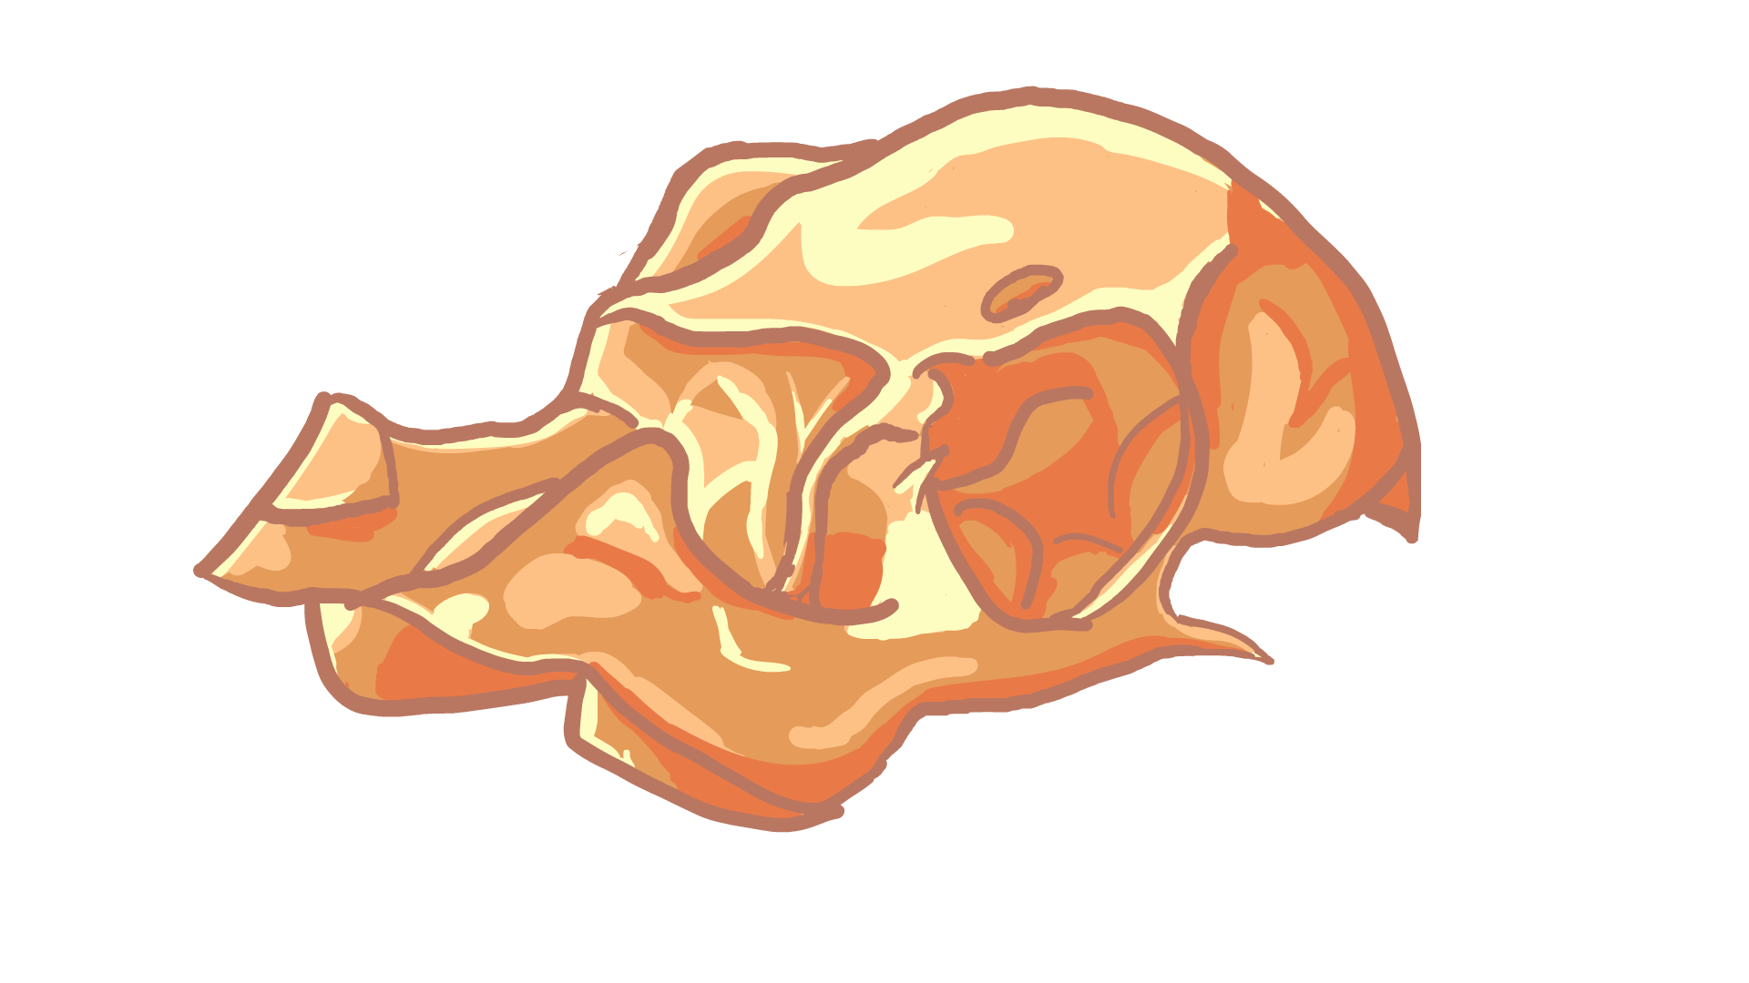
My Projects
Dragon 3D Model
In making this portfolio I open with my project ‘Dragon’ which is close to my heart as it is my first real exploration and self-taught 3d project. Dragon is a complex project currently ‘underway’, the character borne and evolving from my own imagination. Dragon is my current "Lycée" project whereby my professor asked students to create their projects with a rapport between ‘Real and Virtual’.
Heart Installation
It is preferable to open the video in a browser.
Malnutrition à la cafète
Observational Drawings
Some of the observational drawings were made in 2 to 5 minutes

Slide 4
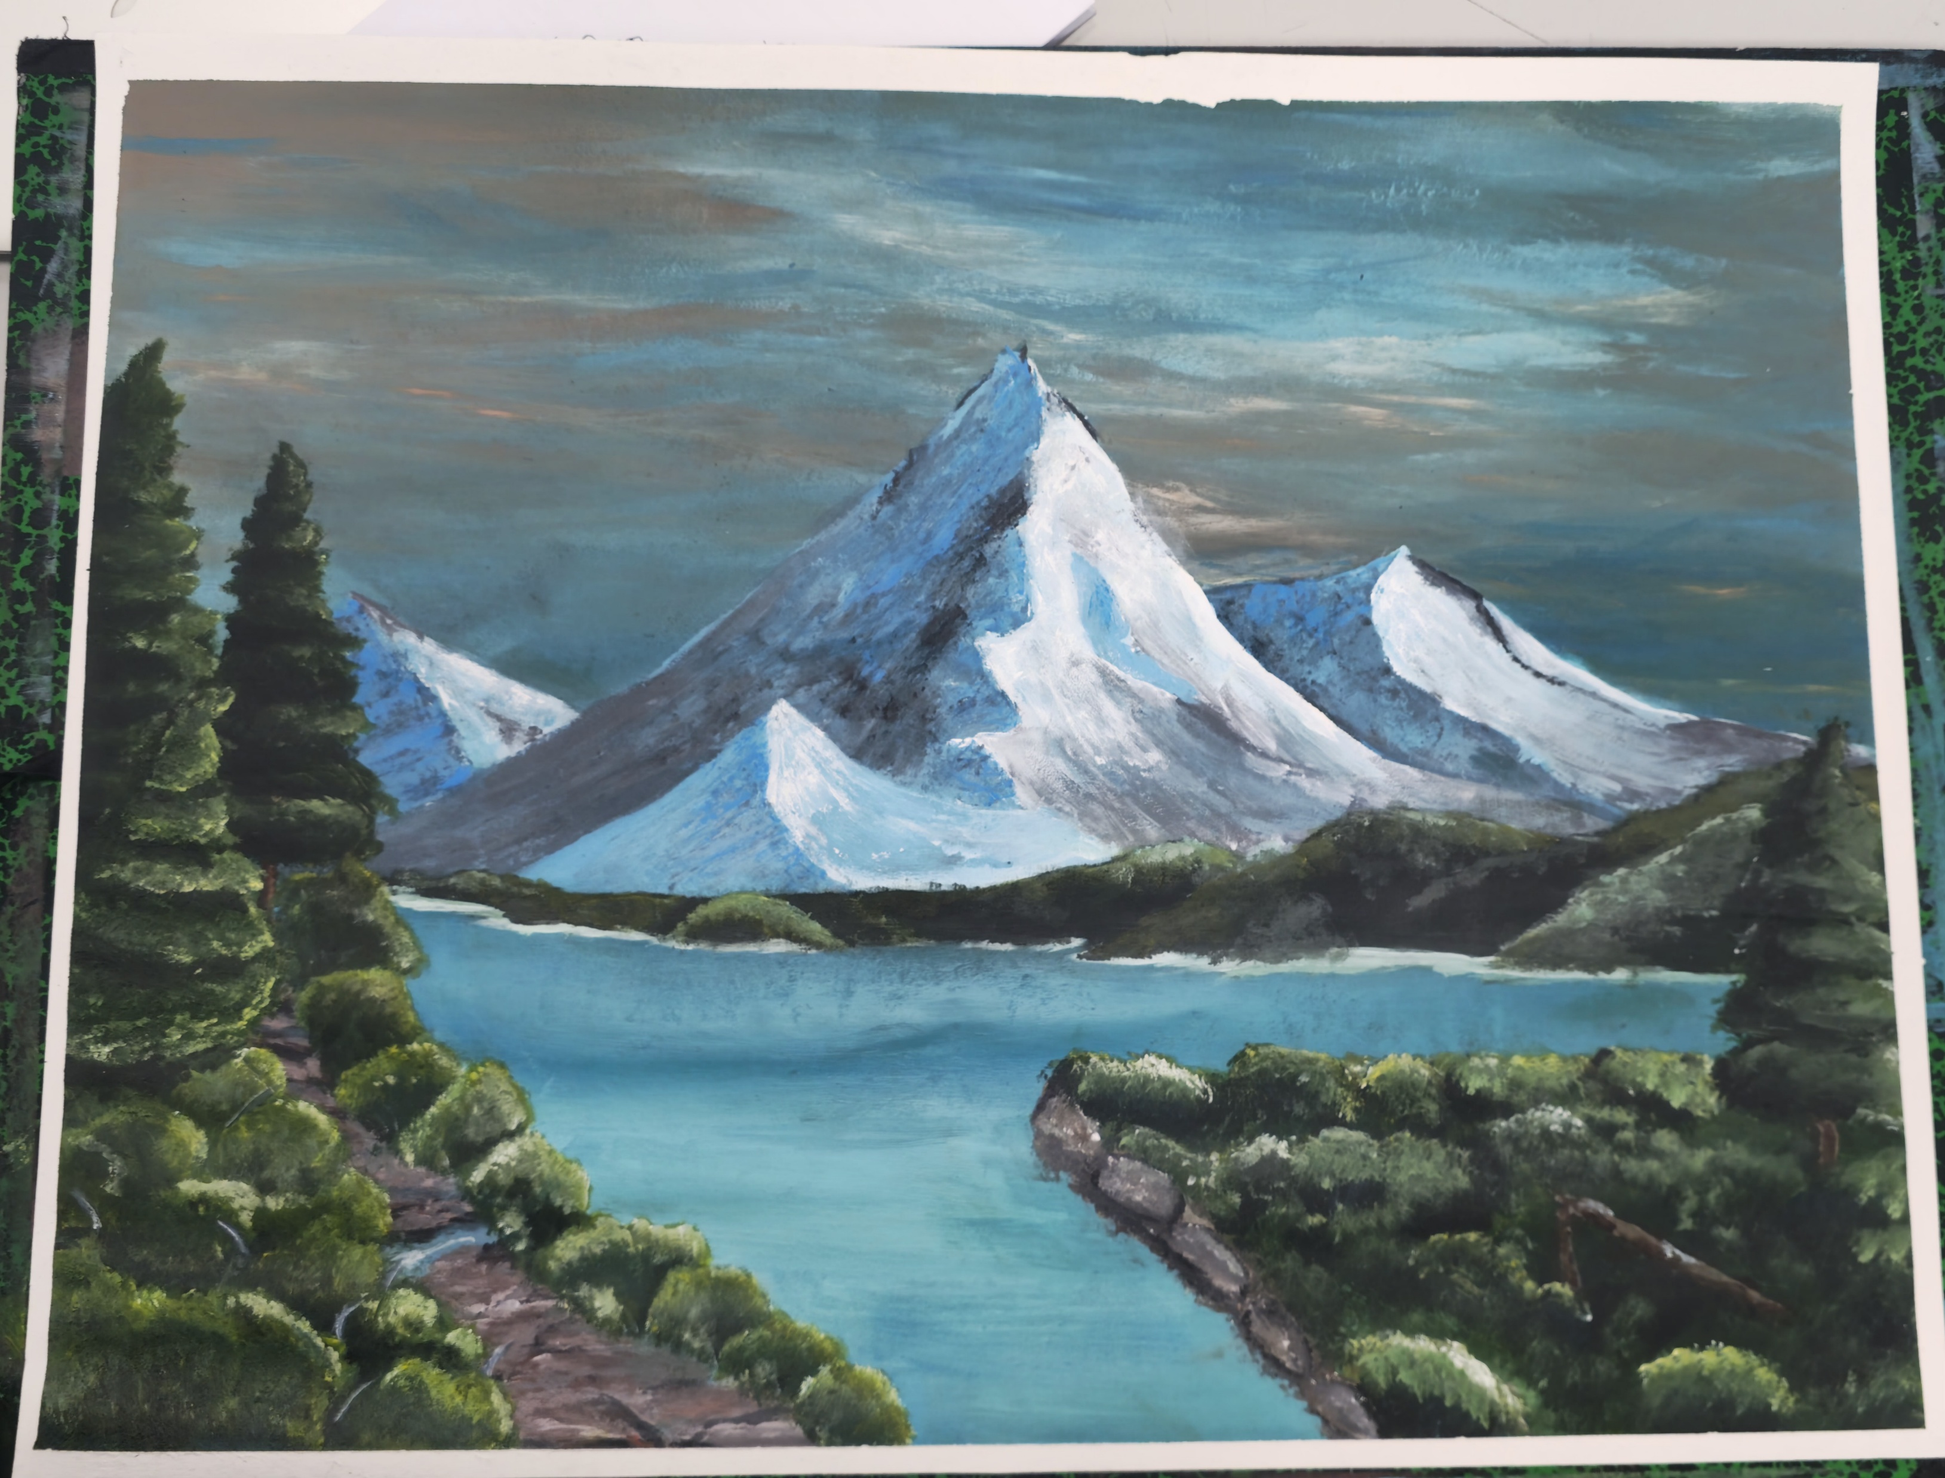
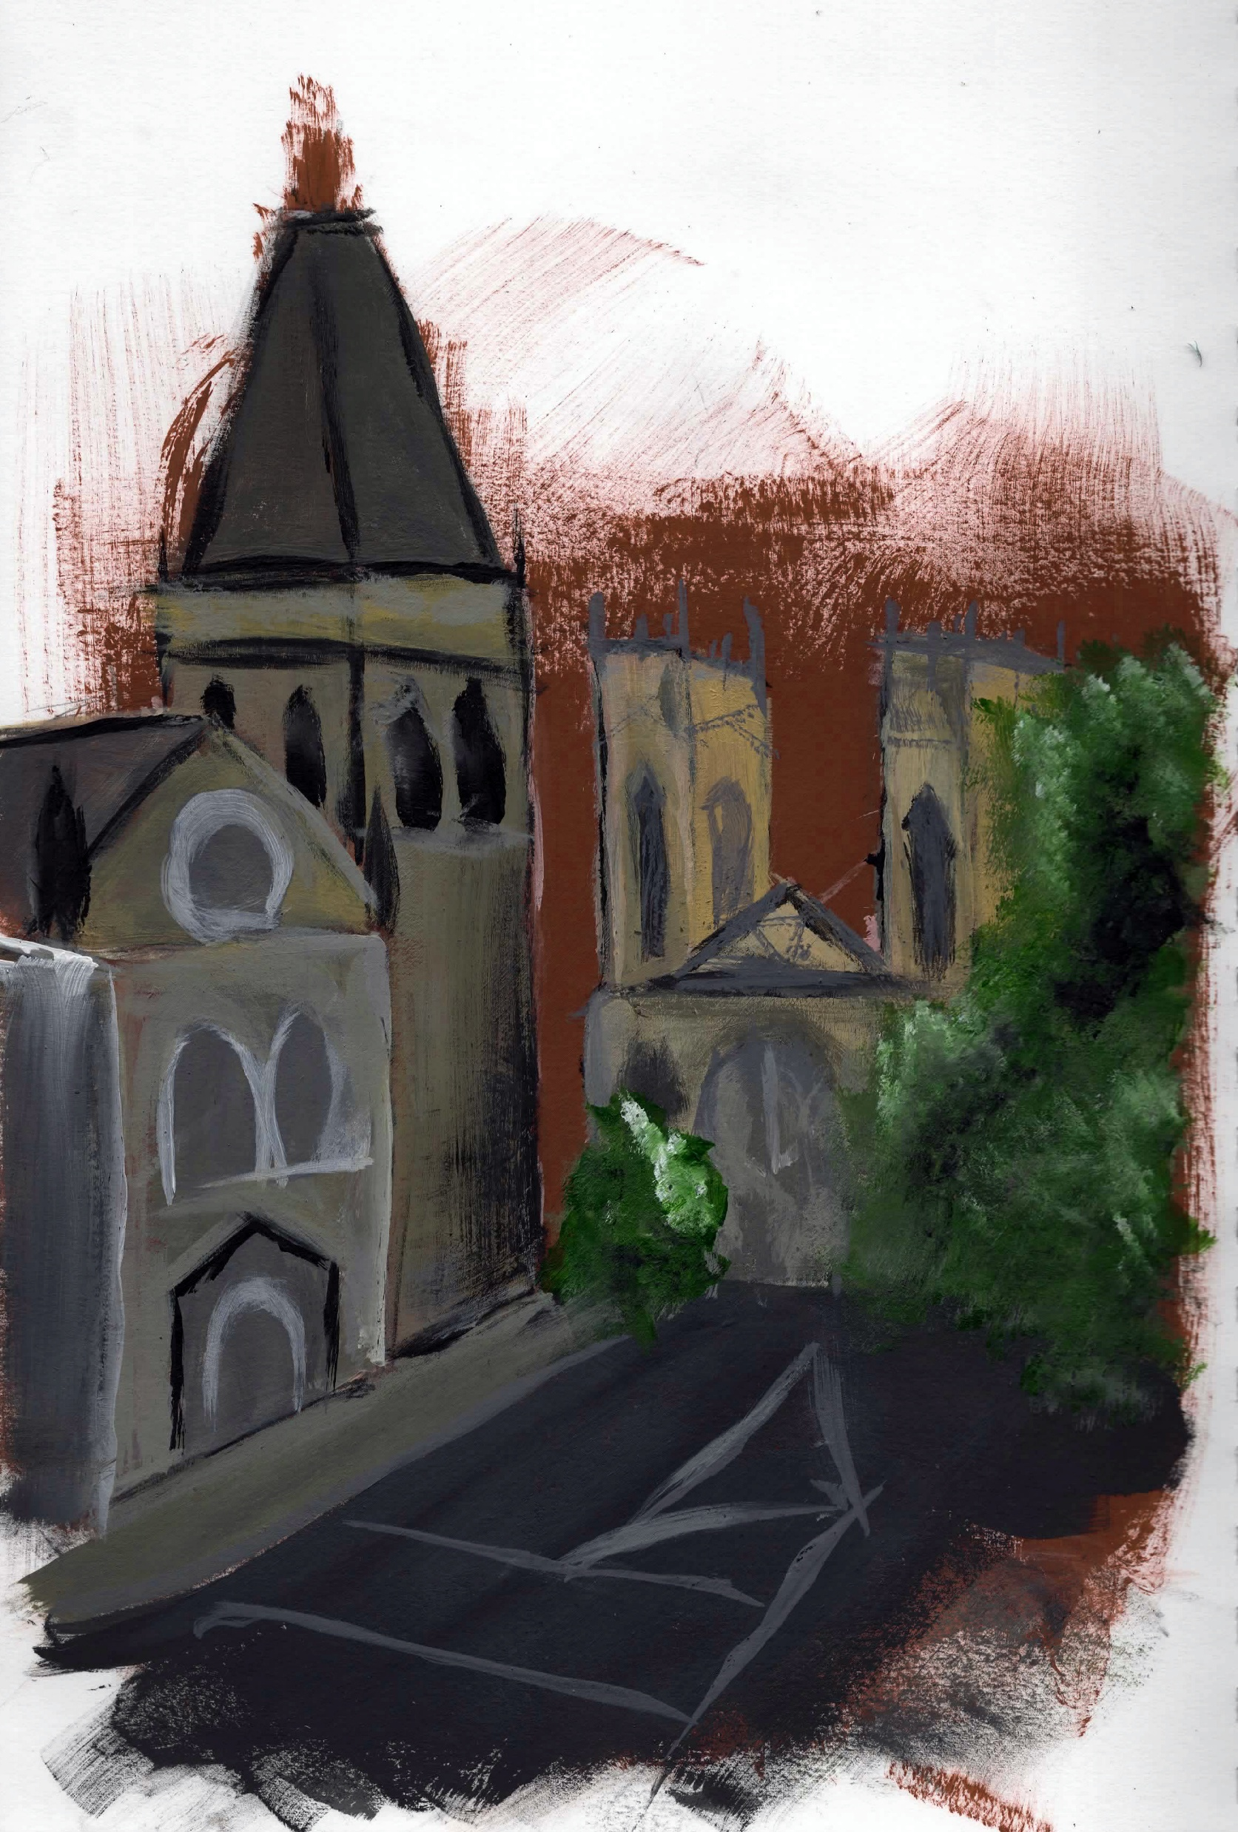
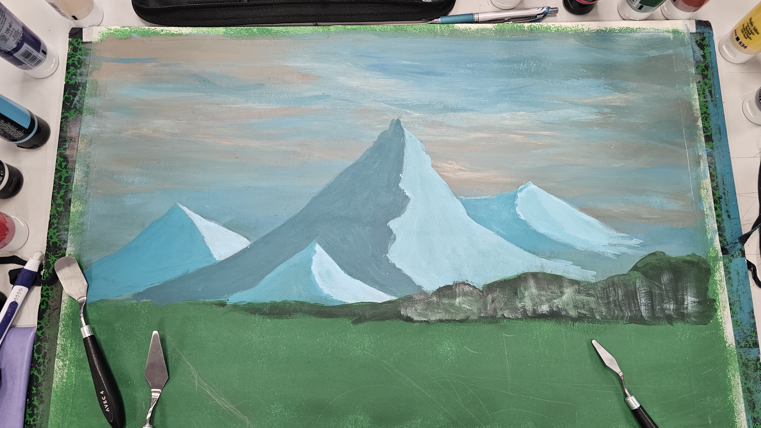
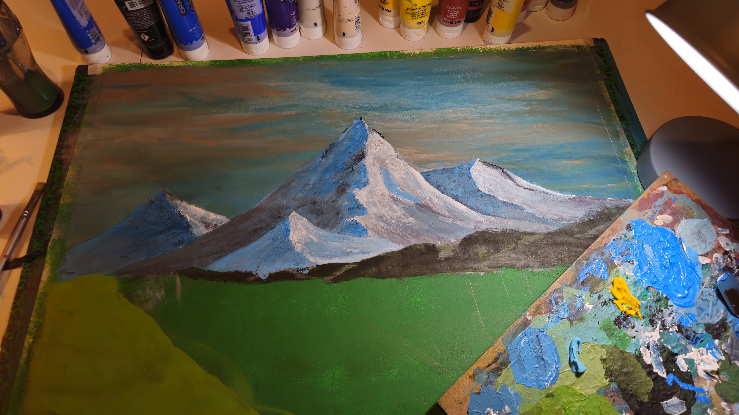
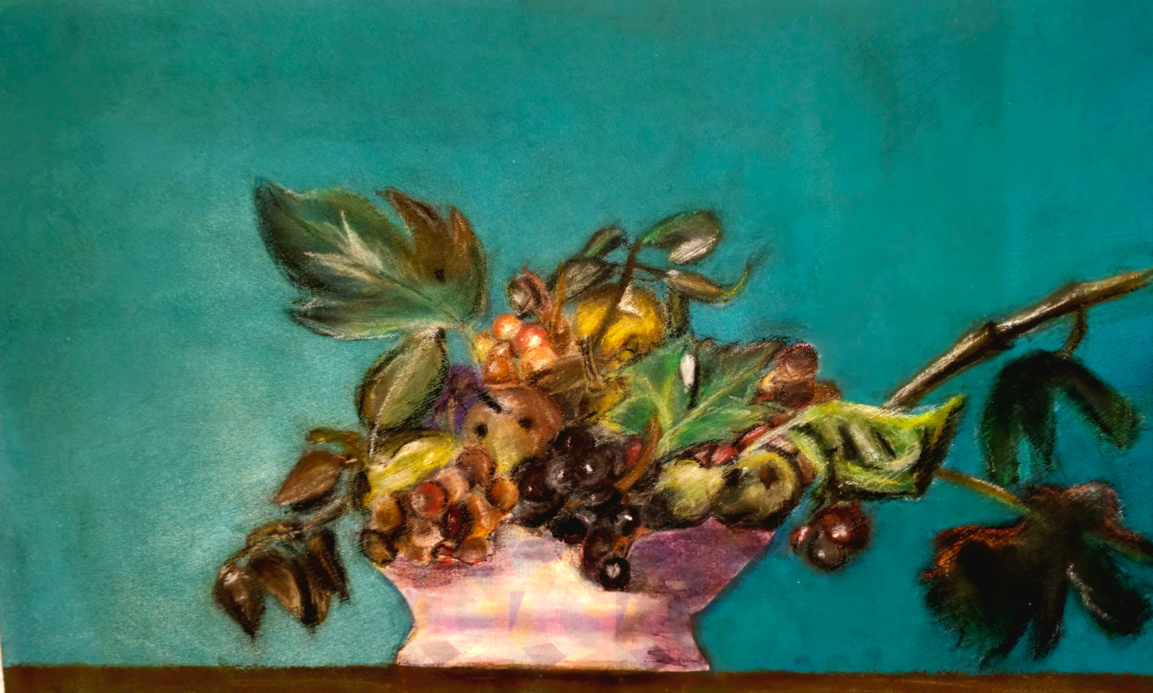
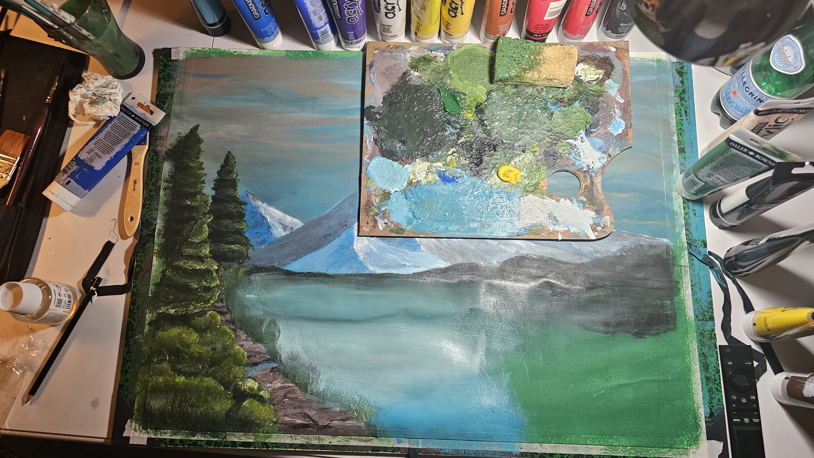
Heart Installation
It is preferable to open the video in a browser.
Malnutrition à la cafète
Observational Drawings
Some of the observational drawings were made in 2 to 5 minutes
The painting and pastel still life are results from observational drawing
Process
of the painting
below
York Observation around the city

Slide 5
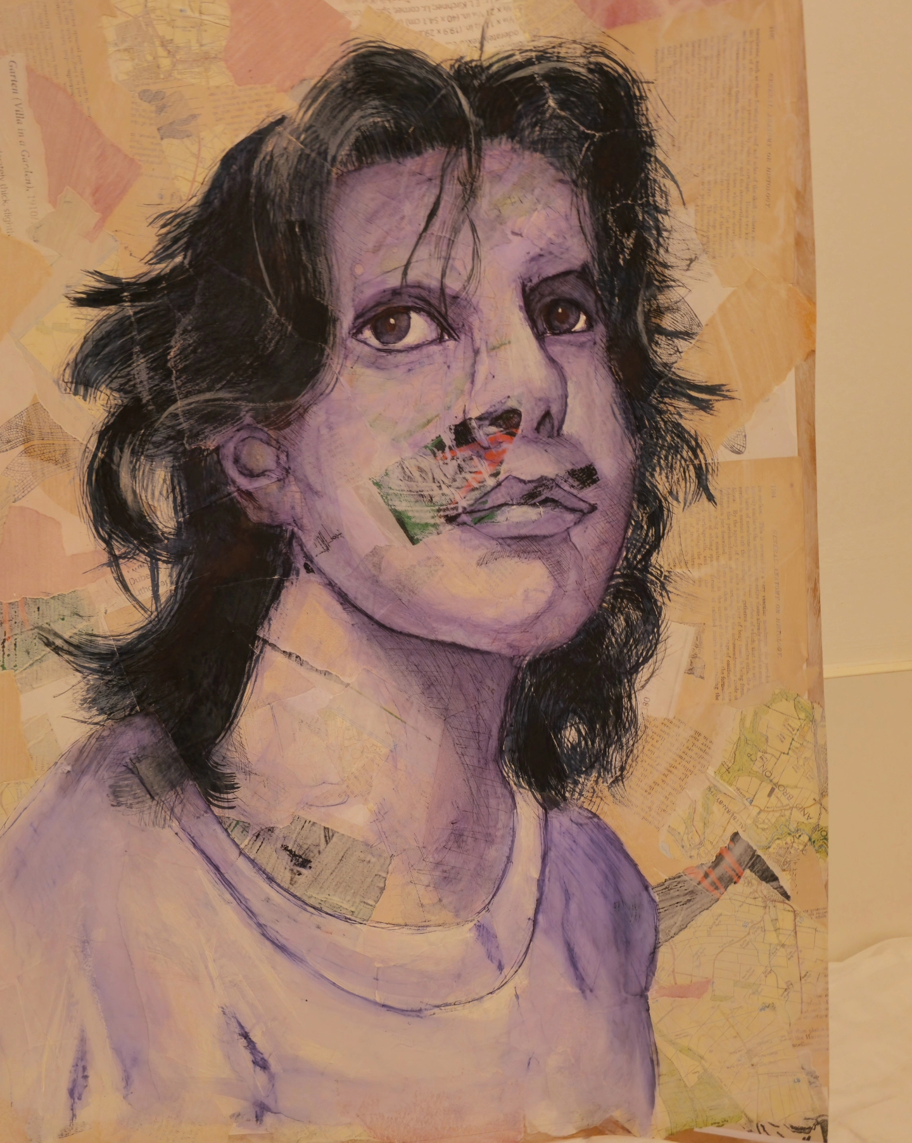
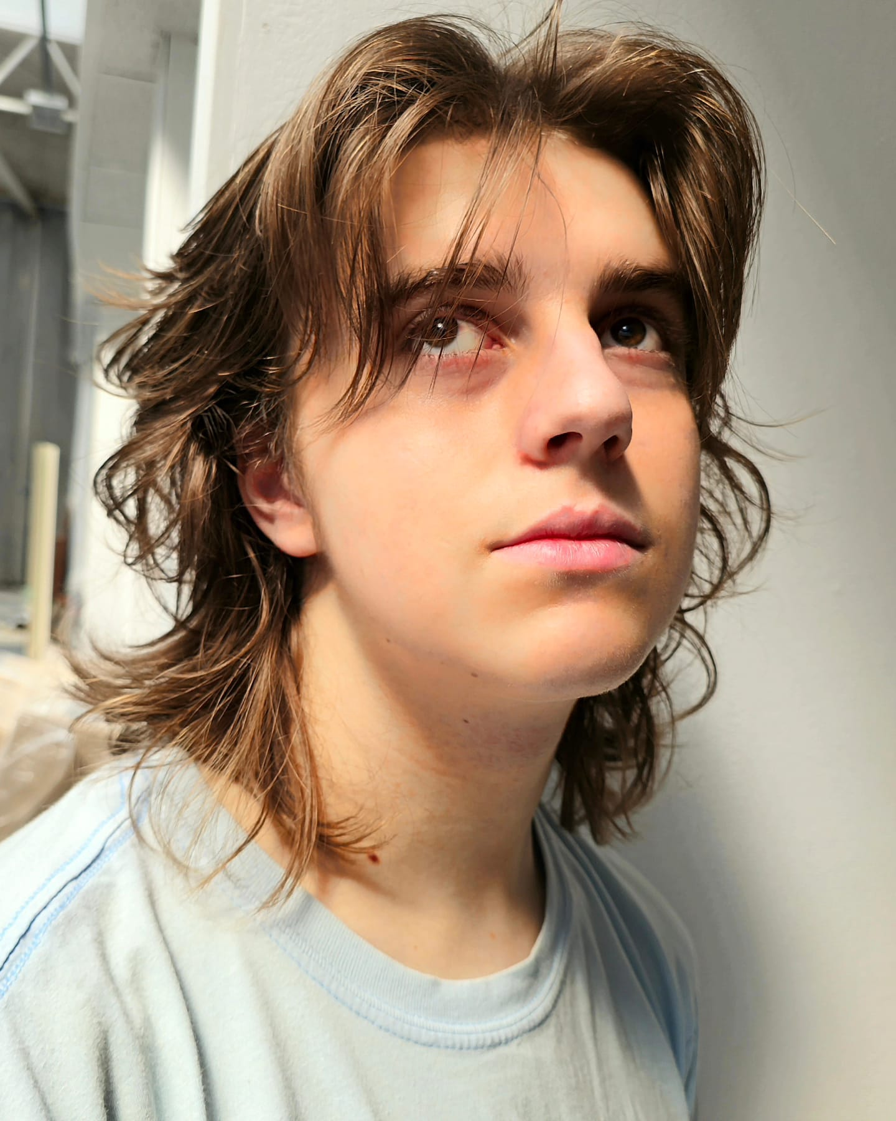
Observational Drawings
Some of the observational drawings were made in 2 to 5 minutes
The painting and pastel still life are results from observational drawing
Process
of the painting
below
York Observation around the city
Self Portrait
A1 self-portrait

Slide 6
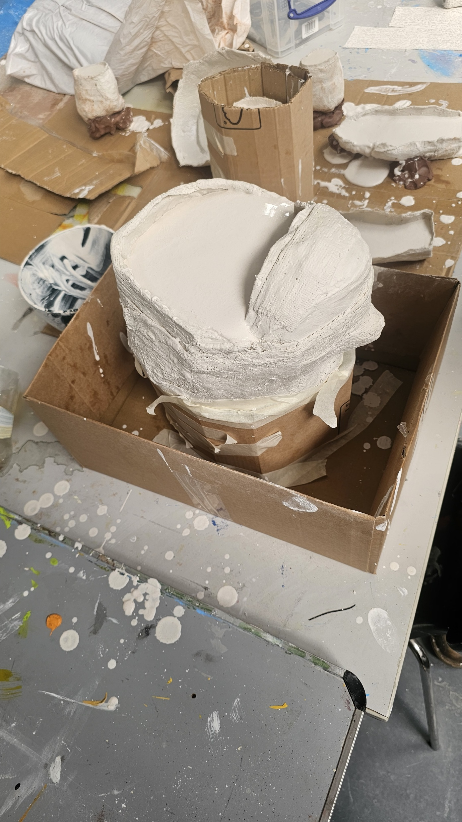
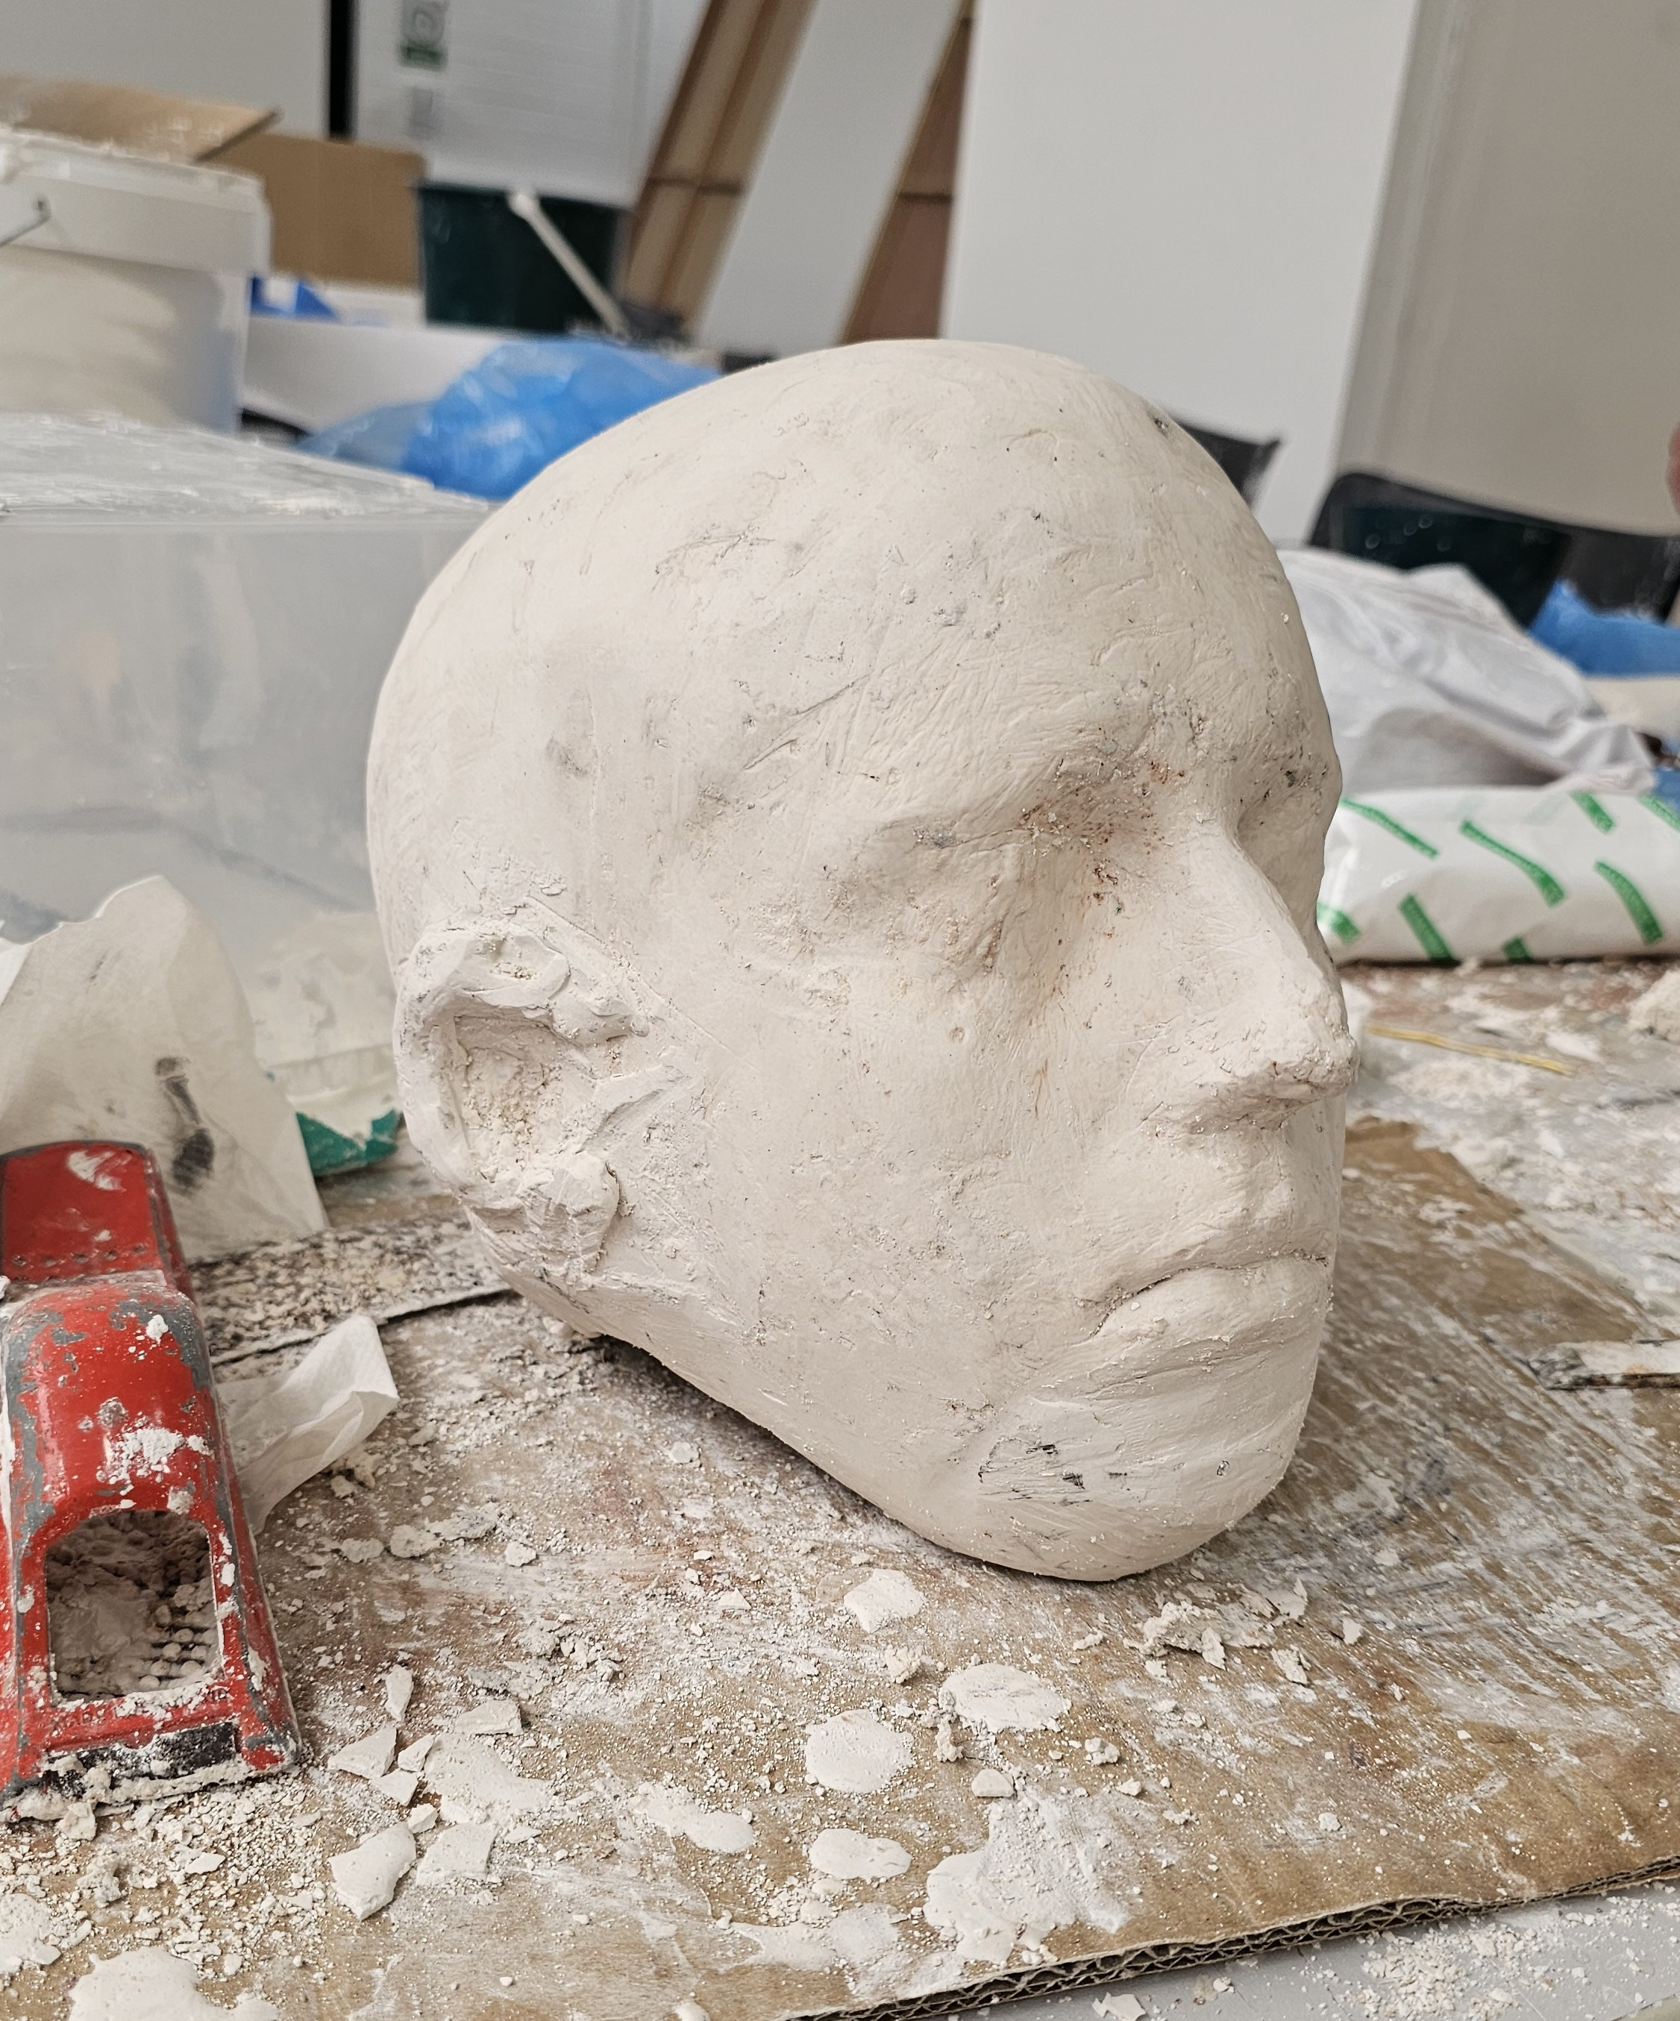
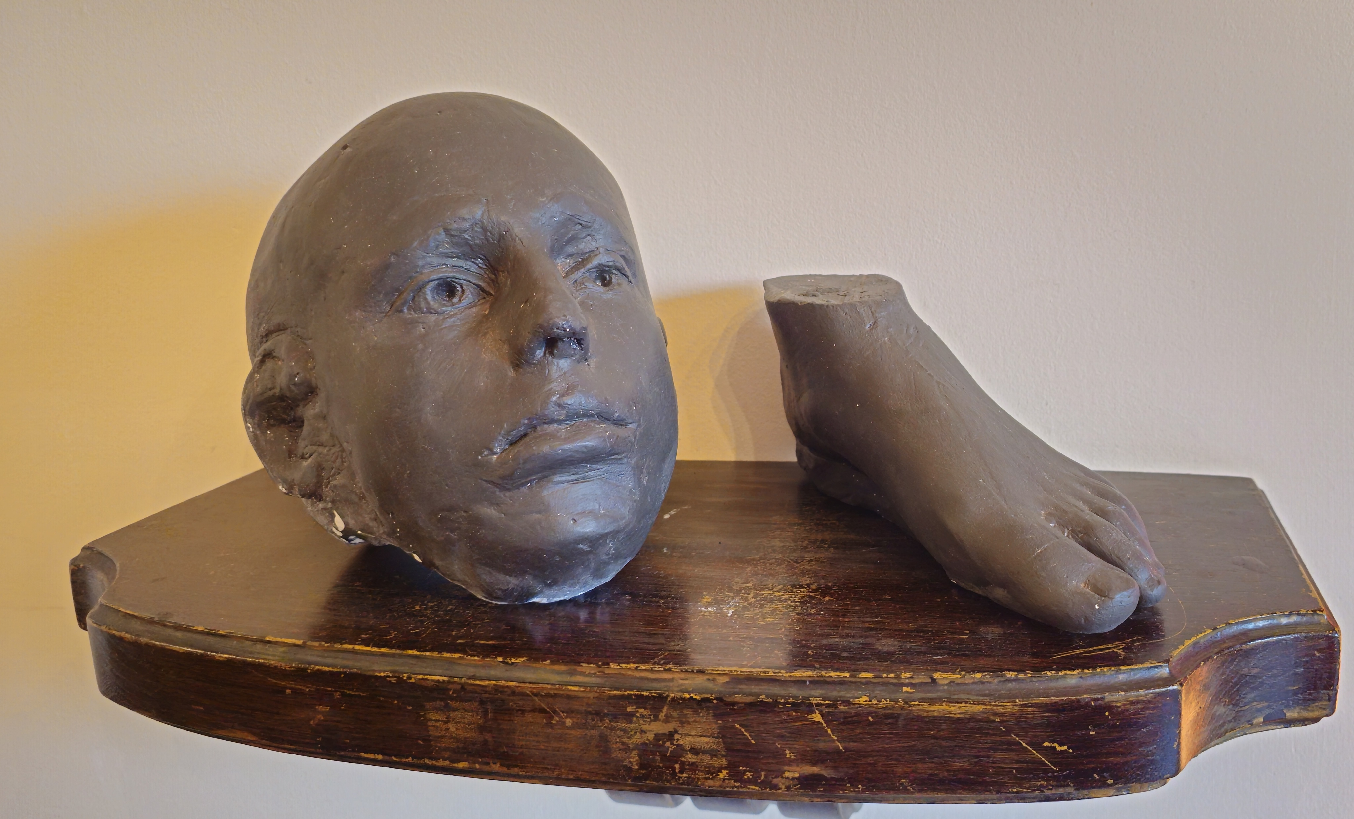
The painting and pastel still life are results from observational drawing
Process
of the painting
below
York Observation around the city
Self Portrait
A1 self-portrait
Body Molding and Sculpting
Used water activated plaster to create molds of my head and foot and then sculpt for more detail.

Slide 7
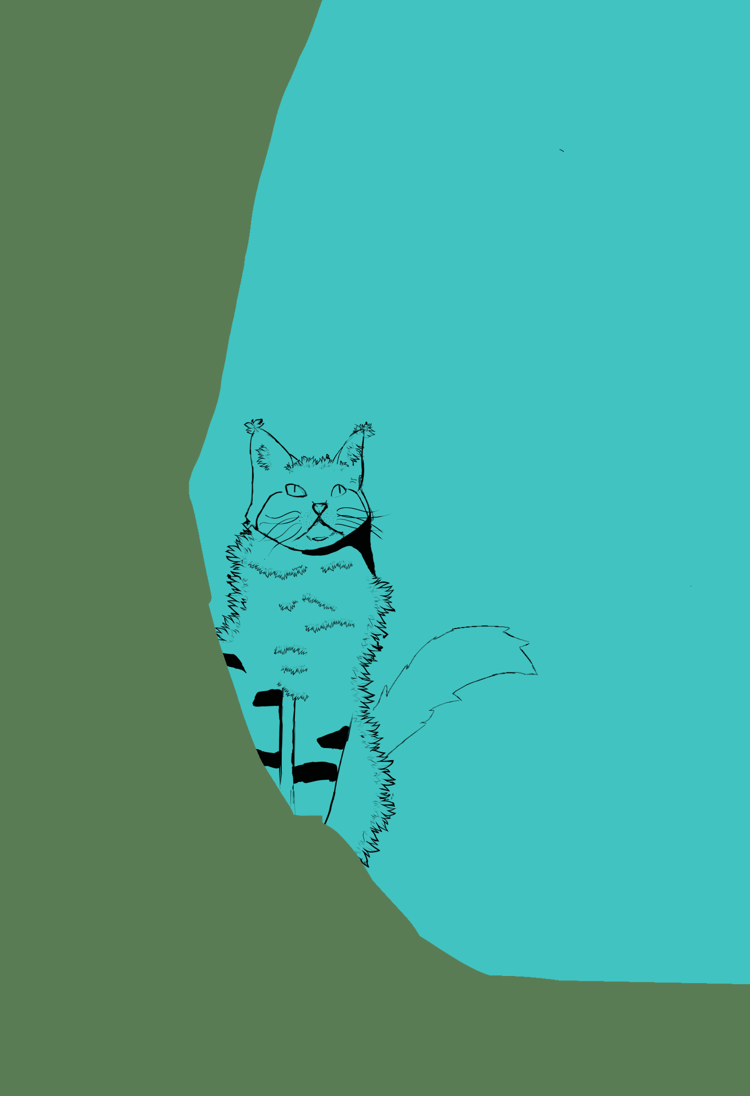
Self Portrait
A1 self-portrait
Body Molding and Sculpting
Used water activated plaster to create molds of my head and foot and then sculpt for more detail.
Digital Illustrations

Slide 8
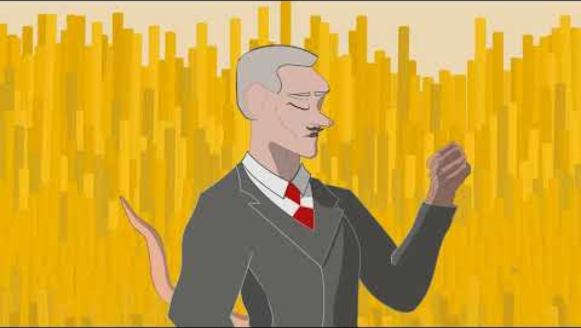
Body Molding and Sculpting
Used water activated plaster to create molds of my head and foot and then sculpt for more detail.
Digital Illustrations
First 2D Animation
RAT depicting human greed

Slide 9
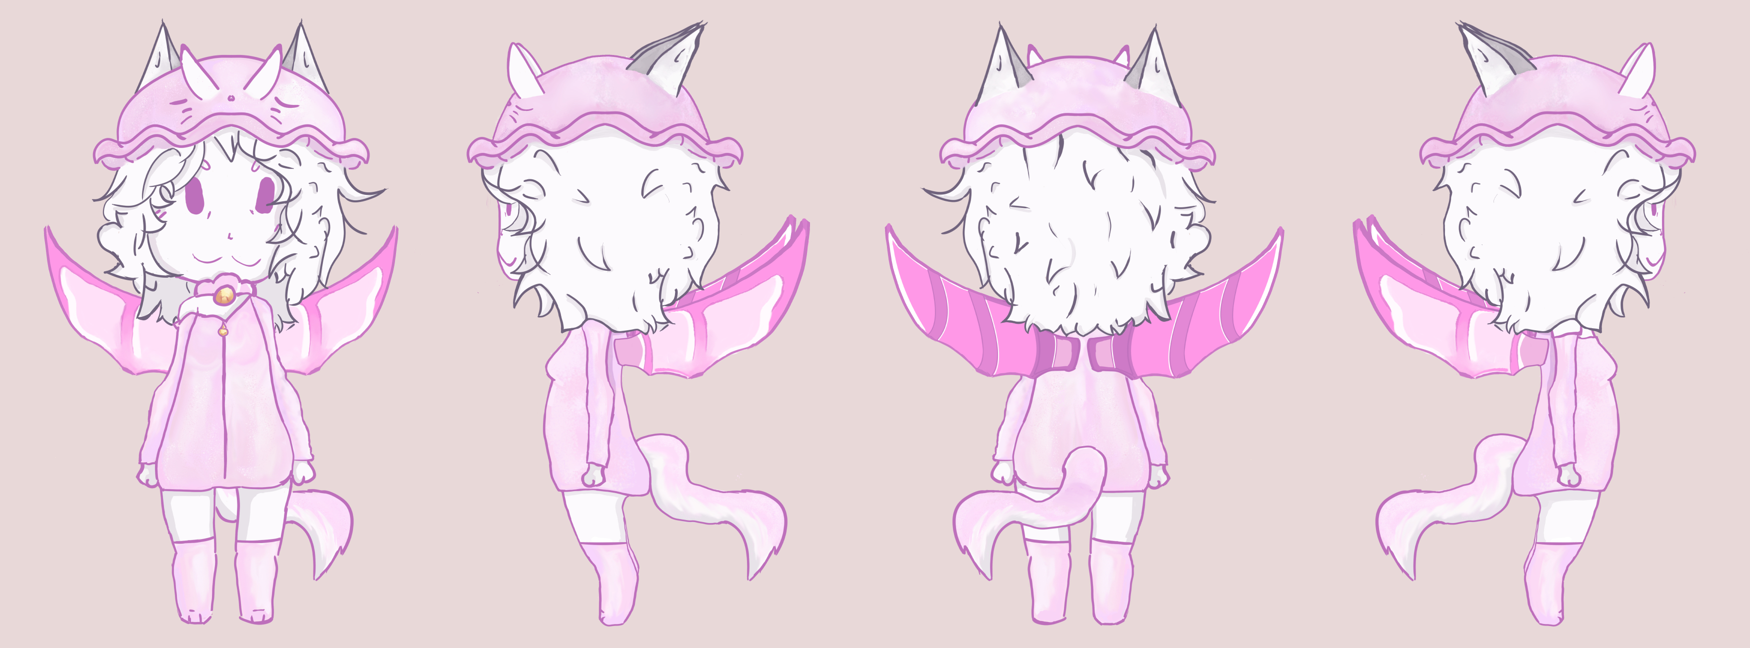
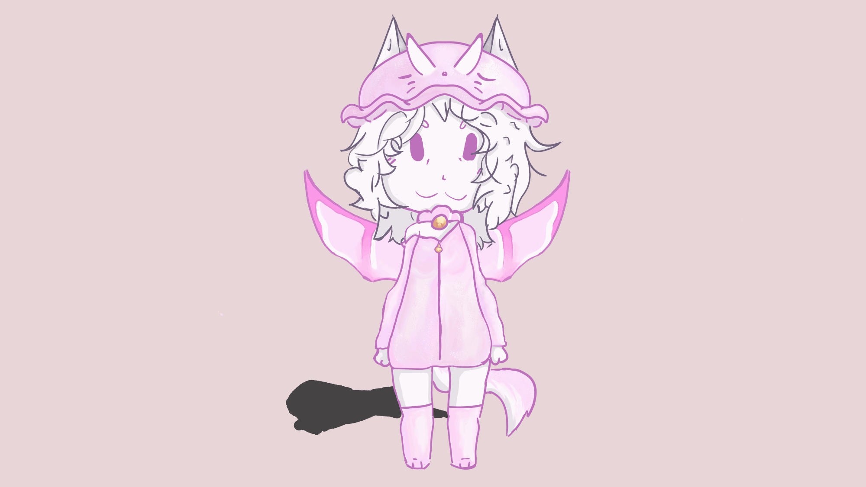
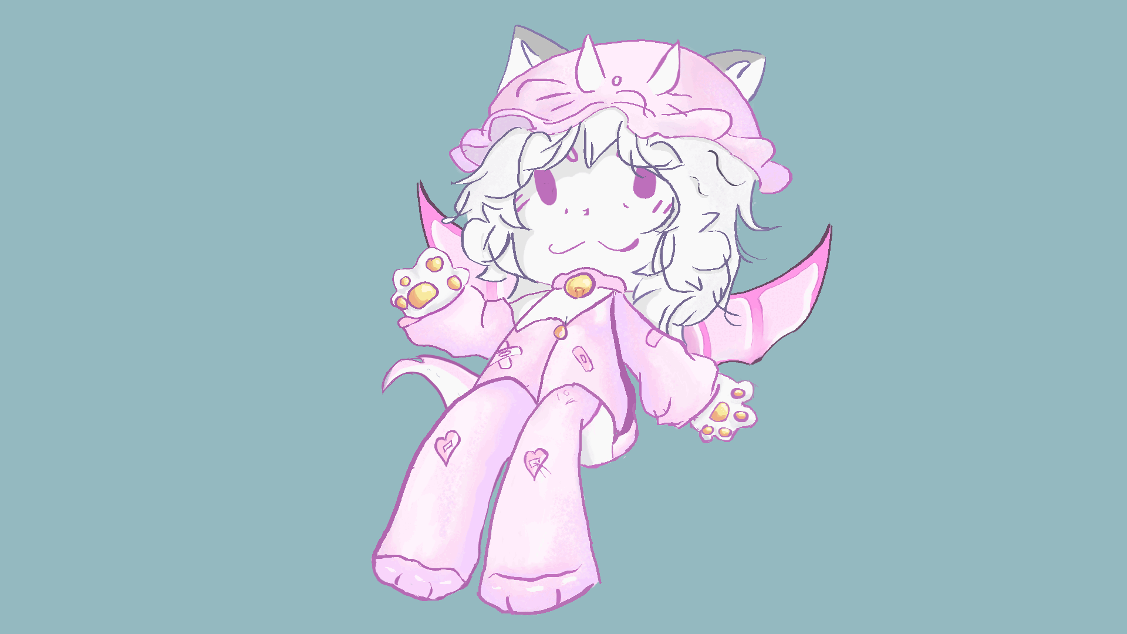
Digital Illustrations
First 2D Animation
RAT depicting human greed
Lizzy-Character design

Slide 10
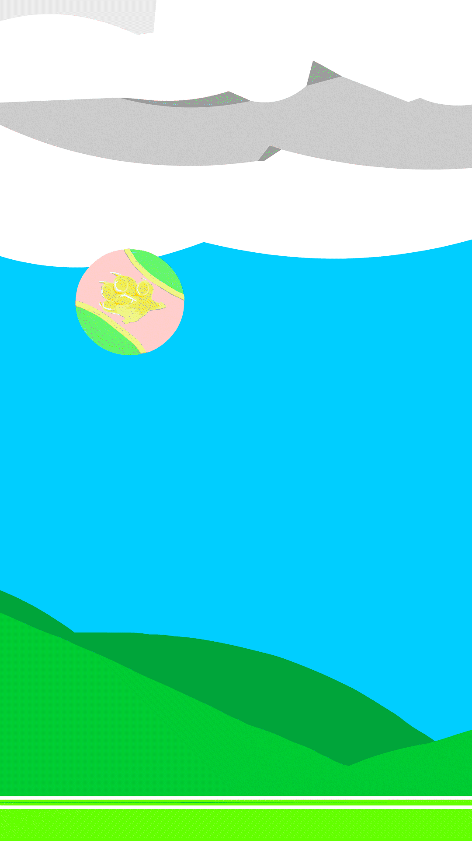

First 2D Animation
RAT depicting human greed
Lizzy-Character design
Digital Illustrations
Simple 2D Animations
Lizzy and loops Created during 2024 NTU summer Animation Course

Slide 11
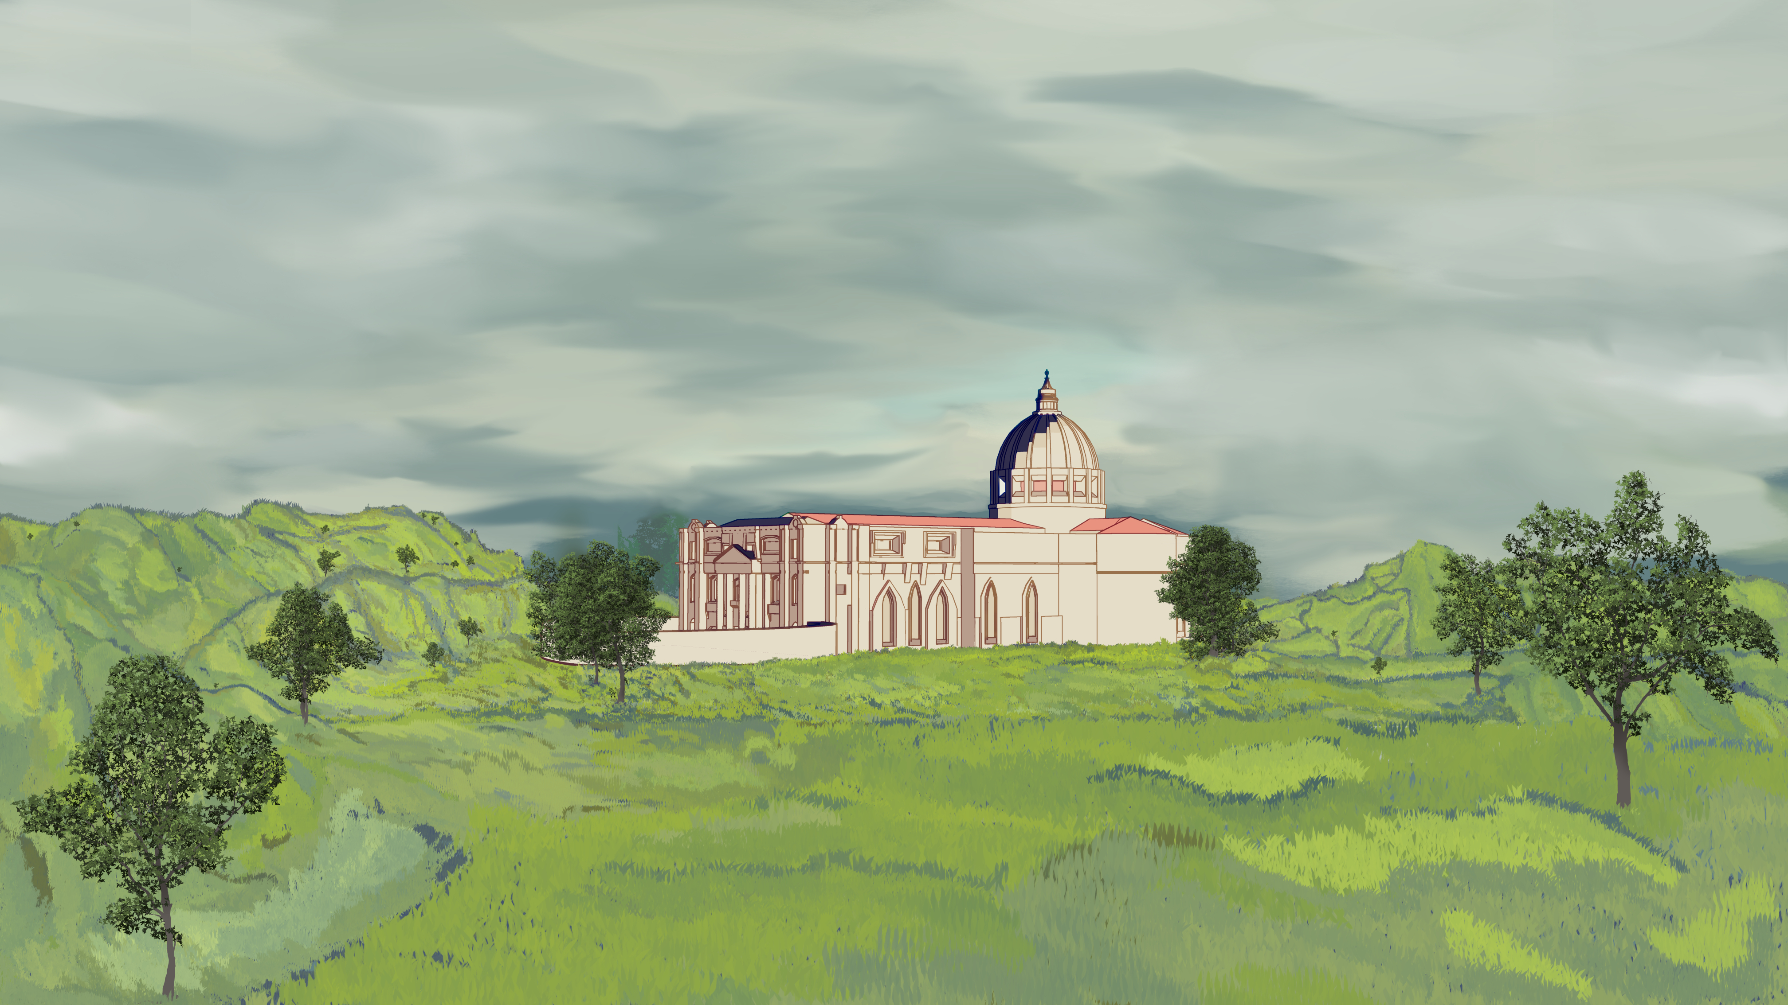
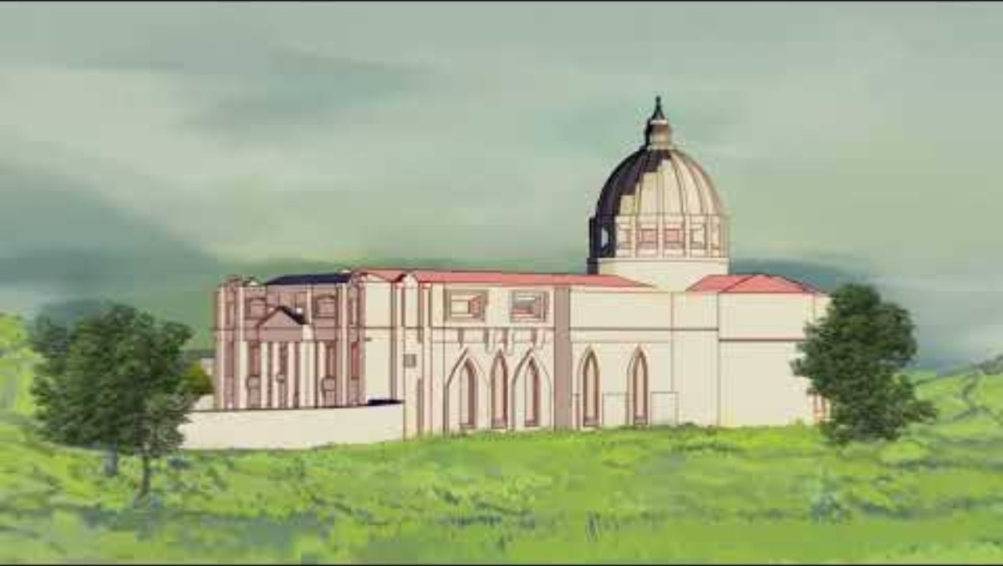
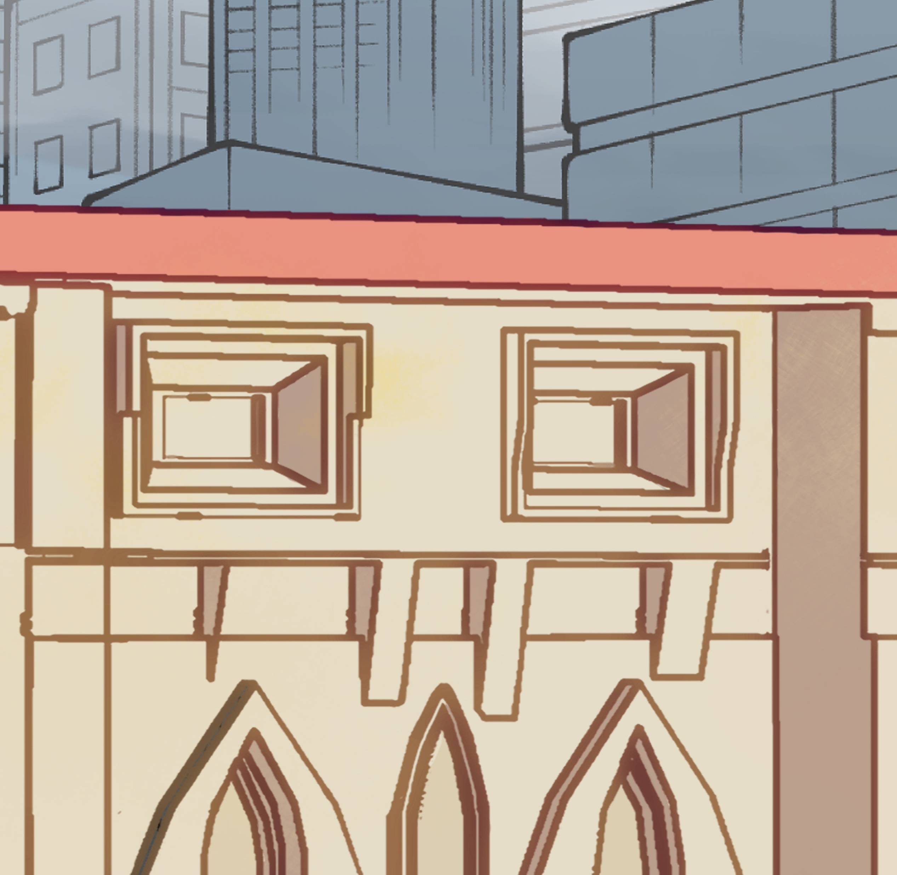
Lizzy-Character design
Digital Illustrations
Simple 2D Animations
Lizzy and loops Created during 2024 NTU summer Animation Course
Infinite zoom Animation
Make sure to loop the video!
Loop portraying the changing architecture around the Cathedral

Slide 12


Simple 2D Animations
Digital Illustrations
Lizzy and loops Created during 2024 NTU summer Animation Course
Infinite zoom Animation
Make sure to loop the video!
Loop portraying the changing architecture around the Cathedral
Contact me
If you’d like to get in touch, feel free to reach out!
charlieice32@gmail.com
@c__charliee
© 2025 Charlie's Portfolio Made with ❤️

Slide 13
Infinite zoom Animation
Make sure to loop the video!
Loop portraying the changing architecture around the Cathedral
Contact me
If you’d like to get in touch, feel free to reach out!
charlieice32@gmail.com
@c__charliee
© 2025 Charlie's Portfolio Made with ❤️

